Slide 1
Grange Primary
Art
Curriculum Expectations

Slide 2
The Grange Curriculum: Art & Design
 | Nursery | Reception | Year 1 | Year 2 | Year 3 | Year 4 | Year 5 | Year 6
Autumn | Marvellous Me/Look at Me It's Getting Cold/Bears Polar Express/Special Days Introducing the art area and resources including aprons and drying rack. Exploring texture using messy play. | Me and My World My Heroes Introducing Reception class art area, learning where to find tools and equipment. Continuing to encourage recognisable images and giving meaning to marks. | I Am An Artist [Aut1] Introducing sketchbooks, experimenting with mark-making and learning about primary colours. Paul Klee Piet Mondrian Wassily Kandinsky | Our School [Aut1] Looking at architecture and urban landscapes through photography and recording surface textures. Producing a collaborative outcome with printmaking. Zaha Hadid The Boyle Family | Why Do We Make Art? [Aut2] Exploring the purpose of art through the study of cave paintings from Lascaux. Using continuous line and considering the use of perspective. Satoshi Kitamura Pablo Picasso History | Pattern & Pumpkins [Aut1] Making 3D pumpkins from clay. Exploring texture and pattern by printmaking using bubble wrap. Yayoi Kusama | Illustration & Narrative Art [Aut1] Developing a visual response to a text, creating digital art. Raphael, Leonardo, Michelangelo Marjane Satrapi, Mel Tregonning | Recycled Materials Installation [Aut2] Using plastic waste to create an installation. Ifeoma Anyaeji Serge Attukwei Clottey Veronika Richterová Katharine Harvey Geography, Science
Spring | Once Upon a Time 1/Once Upon a Time 2 Exploring colours using paints. Encouraging children to think about what they are drawing and painting and giving meaning to marks. | Spring in Our Step Focus on the word around us and observational images of the world. Drawing spring flowers and photographing signs of spring. | Paper Sculpture Further exploration of mark making. Creating a sculpture by folding and twisting paper and gluing onto a base. Photography of shadow and light. Charles McGee | Colour and Tone [Spr1] Looking at tints, tones and shades in The King Who Banned the Dark and Picasso’s paintings from his Blue Period. Emily Haworth-Booth Pablo Picasso | Clay Fairy Tales Using clay to produce a collaborative visual representation of a fairy tale crime. Anthony Browne Quentin Blake | Watercolour Tropical Rainforest Exploring use of watercolours to create a collaged response to the work of artists studied. Abel Rodriguez Henri Rousseau Henri Matisse Geography | Journeys [Spr1] Looking at Shackleton’s Journey and how artists have portrayed journeys. Collage, printmaking and mixed-media outcomes. Richard Long, Frida Kahlo, Lubaina Himid | Displacement / Challenges [Spr2] Looking at the work of artists who have been refugees or have produced art in different circumstances. Pissarro, Wiltshire, Schwitters, Kerr Geography
Summer | All Creatures Great and Small 1/ All Creatures Great and Small 2 Working towards recognisable images, considering the features of things being drawn and painted. | Where We Live Science Detectives Encouraging reflection when creating art pieces, what could be improved or changed for next time? | The Natural World Drawing from observation, printmaking using leaves and introducing secondary colours. Leonardo Da Vinci Claude Monet Frances Hatch | Painting Water Using wax resist and watercolour to create water textures. Exploring collage to create an outcome using suspended fish paintings. Katsushika Hokusai David Hockney Claude Monet Geography | Mythology [Sum2] Representations of myths by artists from different eras. Introduction of key terms: traditional, modern, contemporary. Raphael Van Gogh Frank Auerbach, Chris Ofili History | My Favourite Things [Sum1] Looking at objects from the British Museum using This or That by Goodhart. Drawing a still life based on personal possessions. Pippa Goodhart Joseph Cornell | Pattern & Sculpture Using origami to create bird sculptures out of printed designs exploring pattern and the natural world. Mark Hearld Jackie Morris | Art & Identity [Sum2] Considering the impact of the British Empire on art and how our art can reflect our identity. Drawing the face and creating a shared exhibition. Yinka Shonibare Sonia Boyce [History]
NB: The artists suggested in each unit provide quality examples of practical knowledge and provide exposure to artists from across history from diverse backgrounds. However, you could supplement and replace these artists where appropriate with those from your local area.

Slide 3
Nursery 3/4 (Cycle A)
Half Term | Learning Opportunities | How This Will Build
Aut1: Marvellous Me | Colour: Painting a self-portrait. Beginning to explore colour-mixing. Control of materials: Using a paintbrush. | In Rec and Y2, pupils will draw and paint a simple self-portrait. In Y6, pupils will be taught techniques to accurately draw facial features. Pupils will continually develop their painting skills throughout the primary curriculum.
Aut2: It’s Getting Cold Outside | Texture: Using a range of materials to create a hibernation picture. Control of materials: Collage skills (gluing, cutting with scissors). | In Y2, pupils will explore texture around the school site, creating wax rubbings to inform their printmaking outcome. In Y1, pupils will further develop their fine motor skills to create a paper sculpture by cutting and gluing paper.
Spr2: On the Farm | Colour: Choosing appropriate colours for each element of their image. Texture: Using a range of materials to create a collage. Control of materials: Collage skills, printmaking. | In Y1, pupils will learn about primary and secondary colours. They will also use leaves to explore printmaking. Pupils will have further opportunities to explore collage in Y2 and Y4.
Sum1: Once Upon a Time 1 | Line: Drawing continuous line, vertical and horizontal lines and closed shapes. Texture: Creating textured surfaces to represent brickwork. Control of materials: Using fine motor skills to hold a pencil. | Pupils will explore continuous line in Y1 and Y3. InY2, pupils will explore texture to inform their printmaking experiments.
Sum2: All Creatures Great and Small 1 | Line: Drawing animals using lines and circles. Control of materials: Using pencil to add detail to drawings. | In Y3, pupils will use continuous line to draw animals before adding additional details using a range of materials.
Nursery 3/4 (Cycle A)
Relevant Development Matters (N3/4) statements:
Create closed shapes with continuous lines and begin to use these shapes to represent objects. Draw with increasing complexity and detail, such as representing a face with a circle and including details. | Explore different materials freely, in order to develop their ideas about how to use them and what to make. Explore colour and colour-mixing. Develop their own ideas and then decide which materials to use to express them.

Slide 4
Nursery 3/4 (Cycle B)
Half Term | Learning Opportunities | How This Will Build
Aut1: Look at Me! | Colour: Identify appropriate colours for their self-portrait (e.g., eyes, hair etc.). Line: Draw using continuous line and closed shapes. Control of materials: Collage skills and handling paintbrush. | Children will draw their own face in Rec. In Y2, pupils will draw and paint a simple self-portrait. In Y6, pupils will be taught techniques to accurately draw facial features. Pupils will draw using continuous line in Y3.
Aut2: Bears | Texture: Selecting appropriate materials to create a collaged bear image. Control of materials: Collage skills. | Pupils will have further opportunities to explore collage in Y2 and Y4.
Aut3: Special Days | Colour: Exploring colour-mixing using paint. Texture: Pupils choose collage materials from a selection. Control of materials: Collage skills and handling a paintbrush. | Pupils will learn about primary and secondary colour in Y1. In Y2, pupils will learn how to create tints, tones and shades of a primary colour, and they will explore tertiary colours in Y3.
Spr2: Food Glorious Food | Pattern: Printmaking using vegetables to create a pattern. Control of materials: Printmaking and collage skills. Colour: Colour-mixing using paint. | In Y1, pupils will use leaves in printmaking. They will develop their printmaking skills further in Y2 by creating press-prints and Y4 by creating a collagraphic print.
Sum1: Once Upon a Time 2 | Line: Drawing using continuous line and closed shapes. Texture: Creating a representation of a textured surface using drawing skills. Control of materials: Collage skills | Pupils will draw using a continuous line in Y3. They will develop their drawing skills further in Y4, when they will have the opportunity to draw from direct observation using continuous line as well as a range of other pencil techniques.
Sum2: All Creatures Great and Small 2 | Line: Drawing using continuous line and closed shapes. Control of materials: Using a pencil to draw detail with increasing complexity. Colour: Explore colour-mixing. | Pupils will draw using a continuous line in Y3. They will develop their drawing skills further in Y4, when they will have the opportunity to draw from direct observation using continuous line as well as a range of other pencil techniques.
Nursery 3/4 (Cycle B)
Relevant Development Matters (N3/4) statements:
Create closed shapes with continuous lines and begin to use these shapes to represent objects. Draw with increasing complexity and detail, such as representing a face with a circle and including details. | Explore different materials freely, in order to develop their ideas about how to use them and what to make. Explore colour and colour-mixing. Develop their own ideas and then decide which materials to use to express them.

Slide 5
Reception
Half Term | Learning Opportunities | How This Will Build
Aut1: Me & My World | Colour: Selecting and mixing appropriate colours for their self-portrait (e.g., eyes, hair). Line: Drawing detail with increasing complexity. Control of materials: Using a pencil and paintbrush with an increasing degree of control. | In Y2, pupils will draw and paint a simple self-portrait. In Y6, pupils will be taught techniques to accurately draw facial features.
Aut2: My Heroes | Colour: Using paint to create vegetable prints.= Control of materials: Use of collage skills, careful application of paint during printmaking. | In Y1, pupils will use leaves in printmaking. They will develop their printmaking skills further in Y2 by creating press-prints and Y4 by creating a collagraphic print.
Spr1: Castles, Knights & Dragons | Texture: Using wax crayons to create rubbings of textured surfaces. | In Y2, pupils will create rubbings using different textures around their school site.
Spr2: Spring in Our Step | Colour: Noting the difference between the grey background created using charcoal and the coloured paintings/prints created using more vibrant colours. Control of materials: Using charcoal. Using painting and printmaking skills. | Pupils will explore tints, tones and shades in Y2, during which they will learn more about tone and tonal gradients.
Reception
Relevant Development Matters (Reception) statements:
Explore, use and refine a variety of artistic effects to express their ideas and feelings. Safely use and explore a variety of materials, tools and techniques, experimenting with colour, design, texture, form and function. | Return to and build on their previous learning, refining ideas and developing their ability to represent them.

Slide 6
Year 1: Autumn
I Am An Artist
In this unit, pupils will explore mark-making, line and colour in their sketchbooks.
Year 1: Autumn
 | Knowledge to be reviewed | Knowledge to be explicitly taught | How knowledge will be built upon
Practical | Line: Make marks including lines and closed shapes (EYFS). Colour: Select colours appropriately for a task. Control of Materials: Use mark-making tools with a palmer grasp (N2). Use mark-making tools with a palmer grasp or digital pronate grasp (N3/4). Use mark-making tools with a static tripod grip (N3/4). Use mark-making tools with a dynamic tripod grip (Rec). | Line: A line is a mark made on a surface that joins different points. Lines can vary in length, width, direction and shape. Doing the same thing with different materials - like pencil, crayon, pens, charcoal - can create different lines. Colour Primary colours are red, blue and yellow. They cannot be mixed from other colours. | Line: Use of line to create tone. i.e., ‘what happens if you put your lines close together? Does it look lighter or darker?’ (Y1 Spr). Colour: Mixing of secondary (Y2 Spr) and tertiary colours (Y3 Aut). Mixing of tints, shades and tones (Y2 Spr).
Theoretical | Share their creations, talking about how they have created effects. | Abstract art is art that does not try to look like things in the real world. Instead, it is made up of shapes, colors, and lines that might not look like anything you recognize. Representational art tries to look like things in the real world, such as people, animals, or objects. When you look at representational art, you can usually tell what it is supposed to be. Paul Klee was a Swiss-German artist who lived a long time ago [1866-1944]. He liked to create art by ‘taking a dot for a walk’. Wassily Kandinsky was a Russian artist who lived a long time ago [1910s-1920s]. Piet Mondrian was a Dutch artist who lived a long time ago [1872-1944]. He used bold black lines and primary colours in his work. | Traditional art describes everything from early Christian art to the 1850s and is usually representational (Y3 Sum). Modern art describes art made from around the 1850s to the 1970s. Modern artists wanted their art to show how they felt. It was more abstract than representational (Y3 Sum). Contemporary art describes artwork being made by living artists, or art that has been made recently (e.g., 1980s onwards). Contemporary art can be anything and artists create work using traditional, modern and other techniques (Y3 Sum). Paul Klee, Kandinsky and Piet Mondrian were both modern artists (Y3 Sum).
Disciplinary | Experiment, explore and play with making marks (EYFS). Share their creations, talking about how they have created effects (EYFS). | Artists experiment, explore and play. A sketchbook is a special book that artists use. To discuss the work of artists, including our own. | To label the features (Y1 Sum) and then annotate the features of different artworks with the effects they have on the viewer (Y2 Spr).

Slide 7
Paper Sculptures
Year 1: Spring
In this unit, pupils will produce a paper sculpture.
 | Knowledge to be reviewed | Knowledge to be explicitly taught | How knowledge will be built upon
Practical | Line A line is a mark made on a surface that joins different points (Y1 Aut). Lines can vary in length, width, direction and shape (Y1 Aut). Doing the same thing with different materials - like pencil, crayon, pens, charcoal - can create different lines (Y1 Aut). Control of Materials: Use mark-making tools with a dynamic tripod grip (Rec). | Form: A form is something that you can view from all sides. A form can be created as a sculpture. Tone: Tone is about light and dark in an artwork. A strong tone means there is a big difference (contrast) between the light and the dark areas. Doing the same thing with different materials - like pencil, fineliner, biro, felt tip - can create a different tone. Shadows are an area of darkness that can be created by a sculpture or other object. Space: Space is an area around an object. Space is created when you make a sculpture (e.g. the gap between two parts of the sculpture). Pattern: Patterns can be created with a series of repeated marks like dots and lines. Control of Materials: Use pens - felt tips, fine liners and biros - to draw lines and shapes. | Form: A form can be represented using tone in a 2D artwork (Y4 Sum). Tone: Manipulate shadows using torches to create a different tone (Y2 Spr). Creating tones makes colours look different by making them darker (Y2 Spr). Tone can be created using the same pencil by pressing harder or lighter (Y3 Spr). Tone can be created using different grades of pencil (Y4 Sum). Space & Pattern: Space and patterns can be found in and around existing objects and used to create art (Y2 Aut).
Theoretical | Paul Klee was a Swiss-German artist who lived a long time ago [1879-1940]. He liked to create art by ‘taking a dot for a walk’ (Y1 Aut). Piet Mondrian was a Dutch artist who lived a long time ago [1872-1944]. He used bold black lines and primary colours in his work (Y1 Aut). Abstract art is art that does not try to look like things in the real world. Representational art tries to look like things in the real world (Y1 Aut). | Charles McGee was an American artist who made artwork in living memory. He made paintings and sculptures. Art can be flat [2D] or something that you look around [3D]. A sculpture is an artwork can be viewed from all sides [it is 3D]. A sculptor is an artist who makes sculptures. | Charles McGee was a contemporary artist.
Disciplinary | Artists experiment, explore and play (Y1 Aut). A sketchbook is a special book that artists use (Y1 Aut). To discuss the work of artists, including our own (Y1 Aut). |  | To label the features (Y1 Sum) and then annotate the features of different artworks with the effects they have on the viewer (Y2 Spr).
Year 1: Spring

Slide 8
Natural World
Year 1: Summer
In this unit, pupils will produce a series of drawings of leaves, will print a leaf onto fabric and use wax resist.
 | Knowledge to be reviewed | Knowledge to be explicitly taught | How knowledge will be built upon
Practical | Line: Doing the same thing with different materials - like pencil, crayon, pens, charcoal - can create different lines (Y1 Aut). Tone: Tone is about light and dark in an artwork. Shadows are an area of darkness that can be created by a sculpture or other 3D object (Y1 Spr). Form: A form is something that you can view from all sides [it is 3D] (Y1 Spr). Colour: Primary colours are red, blue and yellow. They cannot be mixed from other colours (Y1 Aut). Control of Materials: D&T: Shape paper with scissors and by folding and twisting (Y1 Aut). Use pencils to draw lines and shapes (EYFS). | Shape: Drawing can be about representing flat objects using shapes on paper. Colour: Secondary colours are green, orange and purple. They are mixed from primary colours. Control of Materials: Use wax crayons to draw lines and shapes. Use the wax resist technique using watercolour paints. Mix colours using watercolour paints on the page (not in a palette). Use a flat wash brushstroke with watercolour paint. Press print onto paper or fabric using the natural colour of the leaves. | Shape: Drawing can be about representing 3D forms with 2D shapes on paper (Y4 Sum). Colour: Mixing of tints, shades and tones (Y2 Spr). Mixing of tertiary colours (Y3 Aut). Control of Materials: Using a range of brushstrokes (including stippling, tapered and dry brushstrokes) and techniques (including wet on wet, and different amounts of water) with watercolour paints (Y2 Sum). Mono-printing (Y2 Aut) and collagraphic printmaking (Y4 Aut).
Theoretical | Abstract art is art that does not try to look like things in the real world. Representational art tries to look like things in the real world (Y1 Aut). | Leonardo Da Vinci was an Italian artist who lived a very long time ago [1452-1519]. He created artwork that was inspired by nature, including leaf prints and observational drawings of living things. Claude Monet was a French artist who made art a long time ago [1840-1926]. He painted representational art outdoors to capture the way that light can change a scene. Frances Hatch is a British artist who makes art today. She creates artwork that is inspired by nature. | Raphael, Michelangelo and Leonardo are traditional artists whose art told stories around the 1500s (Y5 Aut). Monet was a modern artist (Y3 Sum).
Disciplinary | Artists experiment, explore and play (Y1 Aut). A sketchbook is a special book that artists use (Y1 Aut). To discuss the work of artists, including our own (Y1 Aut). | Artists can be inspired by the natural world. Label the features of different artworks with key words. | Annotate the features of different artworks with the effects they have on the viewer (Y2 Spr).
Year 1: Summer

Slide 9
Year 2: Autumn
Our School
In this unit, pupils will produce a collaborative printmaking outcome based on the school site.
Year 2: Autumn
c | Knowledge to be reviewed | Knowledge to be explicitly taught | How knowledge will be built upon
Practical | Tone: Tone is about light and dark in an artwork. A strong tone means there is a big difference (contrast) between the light and the dark areas (Y1 Spr). Shadows are an area of darkness that can be created by a sculpture or other 3D object (Y1 Spr). Space: Space is an area around an object. Space is created when you make a 3D sculpture (e.g. the gap between two parts of the sculpture) (Y1 Spr). Pattern: Patterns can be created with a series of repeated marks like dots and lines (Y1 Spr). Control of Materials: Press print onto paper or fabric using the natural colour of the leaves (Y1 Sum). | Space: Space can be found around existing objects and used to create art. Shapes: Shapes can be found in existing objects and used to create art. Pattern: Identify patterns in the world around us. Texture: Texture is how something feels. Artists can make art that tells us how something might feel, without us having to touch it. Control of Materials: Monoprint onto paper. Using crayons to transfer texture and pattern from existing surfaces. Create a plate to make a press print. Press print onto paper or fabric using a plate. Apply ink (or paint) with a roller. Take photographs using cameras and tablets. | Control of Materials: Collagraphic printmaking is a process in which materials are built up on a plate to be printed from (Y4 Aut). Taking photographs using cameras/tablets of human tableaus (Y3 Sum).
Theoretical | Abstract art is art that does not try to look like things in the real world. Representational art tries to look like things in the real world (Y1 Aut). | Zaha Hadid [1950-2016] was a British-Iraqi architect who designed buildings in living memory. She designed amazing buildings that used curving shapes. The Boyle Family are a group of British artists who have made art in living memory.
Disciplinary | Artists experiment, explore and play (Y1 Aut). A sketchbook is a special book that artists use (Y1 Aut). Artists can be inspired by the natural world (Y1 Sum). Label the features of different artworks with key words (Y1 Sum). | Art can be made by individual artists, or by a group of artists who collaborate. Artists can be inspired by hidden details in seemingly ordinary objects. Artists can be inspired by the artificial (man-made) world. Artists often create art for its own sake. Designers create things that are useful and have a purpose. Architects are artists and designers who design buildings. | Artists can be inspired by each other, and we can make connections between our artworks and theirs (Y3 Sum).

Slide 10
Colour and Tone
Year 2: Spring
In this unit, pupils will create a painting using tints, tones and shades within one colour.
c | Knowledge to be reviewed | Knowledge to be explicitly taught | How knowledge will be built upon
Practical | Tone: Tone is about light and dark in an artwork. A strong tone means there is a big difference (contrast) between the light and the dark areas (Y1 Spr). Shadows are an area of darkness that can be created by a sculpture or other 3D object (Y1 Spr). Space: Space is an area around an object. Space is created when you make a 3D sculpture (e.g. the gap between two parts of the sculpture) (Y1 Spr). Colour: Primary colours are red, blue and yellow. They cannot be mixed from other colours (Y1 Aut). Secondary colours are green, orange and purple. They are mixed from primary colours (Y1 Sum). Control of Materials: Use a dynamic tripod group with a paintbrush (Y1 Aut). | Tone: Manipulate shadows using torches to create a different tone. Colour: Artists can change the way a colour looks by making tints, tones and shades. Tints are made by adding white to a colour. Tones are made by adding grey to a colour. Shades are made by adding black to a colour. (We know that tone is about areas of light and dark. Creating tones makes colours look different by making them darker). Warm colours are red, orange and yellow. Cool colours are blue, purple and green. Colours can be used to represent emotions. For example, red can represent anger and blue can represent sadness. Control of Materials: Mix colours using poster paints in a palette. | Tone: Tone can be created using the same pencil by pressing harder or lighter (Y3 Spr). Tone can be created using different grades of pencil (Y4 Sum). Colour: Tertiary colours are red-orange, yellow-orange, yellow-green, blue-green, blue-purple, red-purple. They are mixed from one primary and one secondary colour (Y3 Aut). Control of Materials: Mix colours using acrylic paints in a palette (Y3 Spr). Mix colours using watercolour paints in a palette (Y4 Spr).
Theoretical | Abstract art is art that does not try to look like things in the real world. Representational art tries to look like things in the real world (Y1 Aut). | Pablo Picasso [1881-1973] was a Spanish artist who made art a long time ago. His Blue Period [1901-04] shows a range of tints, tones and shades in one colour. Emily Howarth-Booth is a British author and illustrator who makes art today. Her work uses a range of tints, tones and shades in one colour. Illustrations help to tell a story. Artists who make illustrations are called illustrators. | Pablo Picasso was a Spanish artist. His Blue Period shows a range of tints, tones and shades in one colour. He was inspired by the Lascaux Cave Paintings to create line drawings of animals (Y3 Aut). While illustrations help to tell a story, narrative art tells a story on its own (Y3 Sum).
Disciplinary | Artists experiment, explore and play (Y1 Aut). A sketchbook is a special book that artists use (Y1 Aut). Discuss the work of artists, including our own (Y1 Aut). Label the features of different artworks with key words (Y1 Sum). | Annotate the features of different artworks and the effects they have on the viewer. | Annotate my artwork with connections to another artist's work (Y4 Aut).
Year 2: Spring

Slide 11
Painting Water
Year 2: Summer
In this unit, pupils will create a 3D collage using watercolours.
c | Knowledge to be reviewed | Knowledge to be explicitly taught | How knowledge will be built upon
Practical | Line: A line is a mark made on a surface that joins different points (Y1 Aut). Colour: Primary colours are red, blue and yellow. They cannot be mixed from other colours (Y1 Aut). Secondary colours are green, orange and purple. They are mixed from primary colours (Y1 Sum). Artists can change the way a colour looks by making tints (adding white), tones (adding grey) and shades (adding black) (Y2 Spr). Pattern: Patterns can be created with a series of repeated marks like dots and lines (Y1 Spr). Control of Materials: Use a dynamic tripod group with a paintbrush, pencil and wax crayon. Use the wax resist technique using watercolour paints (Y2 Spr). Mix colours using watercolour paints on the page (not in a palette). (Y2 Spr). Use a flat wash brushstroke with watercolour paint (Y2 Spr). | Control of Materials: Use stippling, tapered and dry brushstrokes with watercolour paint. Use wet on wet and 'less to more see through' [opaque to translucent] techniques. Use different amounts of water to create stronger [more opaque] and weaker [more translucent] colours. Different paintbrushes are suited to different brush strokes and techniques. | Control of Materials: Mix colours using watercolour paints in a palette (Y4 Spr).
Theoretical | Claude Monet [1840-1926] was a French artist who made art a long time ago. He painted representational art outdoors to capture the way that light can change a scene (Y1 Sum). Abstract art is art that does not try to look like things in the real world. Representational art tries to look like things in the real world (Y1 Aut). Geography: Rivers, lakes, seas and oceans are all bodies of water. Rivers flow into lakes and seas; seas connect to oceans (Y2 Sum). | Katsushika Hokusai [1760-1849] was an Japanese artist who made art a long time ago. He is famous for representational woodblock prints. David Hockney [b. 1937] is a British artist who makes art today [1960s-2020s]. He has painted lots of scenes including water. A collage is an artwork made by sticking pieces of paper or other materials onto a background. | David Hockney is a contemporary artist (Y3 Sum). Traditional, modern and contemporary art definitions can only be applied to western art (Y3 Sum).
Disciplinary | Artists experiment, explore and play (Y1 Aut). Art can be made by individual artists, or by a group of artists who collaborate (Y2 Aut). Artists can be inspired by the natural world (Y1 Sum). Annotate the features of different artworks and the effects they have on the viewer (Y2 Spr).
Year 2: Summer

Slide 12
Year 3: Autumn
Why Do We Make Art?
In this unit, pupils will create a series of animal drawings and paintings.
Year 3: Autumn
c | Knowledge to be reviewed | Knowledge to be explicitly taught | How knowledge will be built upon
Practical | Line: Lines can vary in length, width, direction and shape (Y1 Aut). A continuous line drawing is one where the pencil does not leave the page (Y1 Aut). Control of Materials: Use a dynamic tripod group with a paintbrush (Rec & Y1 Aut). Use a flat wash brushstroke with watercolour paint (Y1 Sum). Mix colours using poster paints in a palette (Y2 Spr). Different paintbrushes are suited to different brush strokes and techniques (Y2 Spr). | Colour: Earthy colours are reds, browns, oranges (colours of the earth). Tertiary colours are red-orange, yellow-orange, yellow-green, blue-green, blue-purple, red-purple. They are mixed from one primary and one secondary colour. Control of Materials: Use chalk pastels to draw on a page using a dynamic tripod grip and using the pastels on their side. When drawing from observation, artists look at the object they're drawing from. | Colour: The appearance of secondary colours can vary according to the amount of each primary colour used (Y4 Spr). Control of Materials: When drawing from primary observation, artists look at the object they're drawing from. When drawing from secondary observation, artists look at a drawing or a copy of object (Y5 Sum).
Theoretical | Pablo Picasso [1881-1973] was a Spanish artist who made art a long time ago. His Blue Period [1901-04] shows a range of tints, tones and shades in one colour (Y2 Spr). History: Prehistoric Britain refers to the study of humans before there was writing. Prehistoric Britain is split into the Stone Age (Palaeolithic, Mesolithic, Neolithic), Bronze Age and Iron Age (Y3 Sum). | The first artists lived in the Palaeolithic Age, between 10,000 and 40,000 years ago. Pablo Picasso was a Spanish artist. His Blue Period (1900-04) shows a range of tints, tones and shades in one colour. He was inspired by the Lascaux Cave Paintings to create line drawings of animals. Satoshi Kitamura is a Japanese author and illustrator to makes art today. He was inspired by the same cave art as Picasso. Mixed-media is artwork that uses more than one art material e.g., paint and pens. | Picasso was a modern artist (Y3 Sum). A montage is a mixed-media artwork including collaged photographs (Y3 Sum).
Disciplinary | Artists experiment, explore and play (Y1 Aut). Art can be made by individual artists, or by a group of artists who collaborate (Y2 Aut). Artists can be inspired by the natural world (Y1 Sum). Annotate the features of different artworks and the effects they have on the viewer (Y2 Spr). | Creating art is something humans have done from the very beginnings of their existence. | Artists can be inspired by each other, and we can make connections between our artworks and theirs (Y3 Sum).

Slide 13
Clay Fairy Tale Tiles
Year 3: Spring
In this unit, pupils will produce a clay tile to illustrate a fairy tale and will contribute to a storyboard told over several clay tiles.
c | Knowledge to be reviewed | Knowledge to be explicitly taught | How knowledge will be built upon
Practical | Tone: Tone is about light and dark in an artwork. A strong tone means there is a big difference (contrast) between the light and the dark areas (Y1 Spr). Form: A form is something that you can view from all sides [it is 3D]. A form can be created as a sculpture (Y1 Spr). Colour: Primary colours are red, blue and yellow. They cannot be mixed from other colours (Y1 Aut). Secondary colours are green, orange and purple. They are mixed from primary colours (Y1 Sum). Tertiary colours are red-orange, yellow-orange, yellow-green, blue-green, blue-purple, red-purple. They are mixed from one primary and one secondary colour (Y3 Aut). Artists can change the way a colour looks by making tints (adding white), tones (adding grey) and shades (adding black) (Y2 Spr). Space: Space is an area around an object. Space is created when you make a 3D sculpture (e.g. the gap between two parts of the sculpture) (Y1 Spr). Texture: Texture is how something feels. Artists can make art that tells us how something might feel, without us having to touch it. Control of Materials: Use a dynamic tripod group with a paintbrush. Mix colours using poster paints in a palette. Different paintbrushes are suited to different brush strokes and techniques. | Tone: Tone can be created using the same pencil by pressing harder or lighter. Control of Materials: Mix colours using acrylic paints in a palette. Make a 3D sculpture using clay. Make a tile using clay. Make a raised relief by adding layers of clay. Slip is a mixture of clay and water and is used as a glue in ceramics. Scoring surfaces before adding slip means the pieces will attach more reliably. | Tone: Tone can be created using different grades of pencil (Y4 Sum). Control of Materials: Make a 3D sculpture that is not a raised relief tile but a more rounded object (Y4 Aut).
Theoretical | Art can be flat [2D] or something that you look around [3D] (Y1 Spr). A sculpture is an artwork can be viewed from all sides [it is 3D]. A sculptor is an artist who makes sculptures (Y1 Spr). Illustrations help to tell a story. Artists who make illustrations are called illustrators (Y2 Spr). | Anthony Browne and Quentin Blake are both British illustrators who make art today. Ceramics is the process of making art from clay. | While illustrations help to tell a story, narrative art tells a story on its own (Y3 Sum).
D | Art can be made by individual artists, or by a group of artists who collaborate (Y2 Aut).
Year 3: Spring

Slide 14
Mythology
Year 3: Summer
In this unit, pupils will create their own representation of a myth using mixed media (more than one material/technique).
c | Knowledge to be reviewed | Knowledge to be explicitly taught | How knowledge will be built upon
Practical | Colour: Describing tints (adding white), tones (adding grey) and shades (adding black) (Y2 Spr). Control of Materials: Take photographs using cameras/tablets (Y2 Aut). | Control of Materials: A tableau vivant is made by standing still to represent the figures in a story.
Theoretical | Abstract art is art that does not try to look like things in the real world. Representational art tries to look like things in the real world (Y1 Aut). Artists studied so far, to consider whether they are traditional, modern or contemporary artists. Illustrations help to tell a story. Artists who make illustrations are called illustrators (Y2 Spr). A collage is an artwork made by sticking pieces of paper or other materials onto a background (Y2 Sum). Mixed-media is artwork that uses more than one art material e.g., paint and pens (Y3 Aut). History: The Ancient Greeks Ancient Greeks believed in multiple gods and wrote myths (Y3 Sum). | Raphael is traditional Italian artist who made art around 1500-1520. Van Gogh is a modern Dutch artist who made art around 1880-1890. Chris Ofili is a contemporary British painter who makes art today (1990s -). Frank Auerbach is a contemporary German-British painter who makes art today (1960s-today). Traditional art describes everything from early Christian art to the 1850s and is usually representational. Modern art describes art made from around the 1850s to the 1970s. Modern artists wanted their art to show how they felt. It was more abstract than representational. Contemporary art describes artwork being made by living artists, or art that has been made recently (e.g., 1980s onwards). Contemporary art can be anything and artists create work using traditional, modern and other techniques. Traditional, modern and contemporary art definitions can only be applied to western art. Artists can arrange objects or images in a composition. A montage is a mixed-media artwork including collaged photographs. Traditional composition is often made up of foreground, midground and background. Perspective is the way a flat (2D) image looks deep (3D). Illustrations help to tell a story. Artists who make illustrations are called illustrators. Narrative art tells a story on its own. | Applying knowledge of traditional, modern and contemporary to all future artists studied. A still life is a genre of artwork that shows a collection of objects (Y4 Sum). Expressive art conveys emotions and feelings. There are more examples of expressive art in modern and contemporary than traditional art. Expressive art can be representational or abstract (Y5 Spr).
Disc. | Annotate the features of different artworks and the effects they have on the viewer (Y2 Spr). | Artists make choices about materials that are appropriate for their composition. Artists can be inspired by each other, and we can make connections between our artworks and theirs. | Annotate my artwork with connections to another artist's work (Y4 Aut). Compare in detail the artwork of two artists (Y5 Aut)
Year 3: Summer

Slide 15
Pattern and Pumpkins
Year 4: Autumn
In this unit, pupils will make a three-dimensional clay model of a pumpkin.
Year 4: Autumn
c | Knowledge to be reviewed | Knowledge to be explicitly taught | How knowledge will be built upon
Practical | Form: A form is something that you can view from all sides [it is 3D]. A form can be created as a sculpture (Y1 Spr) Colour: Primary colours are red, blue and yellow. They cannot be mixed from other colours (Y1 Aut). Secondary colours are green, orange and purple. They are mixed from primary colours (Y1 Sum). Tertiary colours are red-orange, yellow-orange, yellow-green, blue-green, blue-purple, red-purple. They are mixed from one primary and one secondary colour. Earthy colours are reds, browns, oranges (colours of the earth) (Y3 Aut). Pattern: Patterns can be created with a series of repeated marks like dots and lines (Y1 Spr). Texture: Texture is how something feels. Artists can make art that tells us how something might feel, without us having to touch it (Y2 Aut). Control of Materials: Painting – Use of dynamic tripod group with a paintbrush with acrylic paints. Ceramics – Make a 3D sculpture using clay. Slip is a mixture of clay and water and is used as a glue in ceramics. Scoring surfaces before adding slip means the pieces will attach more reliably (Y3 Spr). Printing – Press print onto paper or fabric using the natural colour of the leaves (Y1 Sum). Monoprint onto paper. Create a plate to make a press print. Press print onto paper or fabric using a plate. Apply ink (or paint) with a roller (Y2 Aut). | Control of Materials: Collagraphic printmaking is a process in which materials are built up on a plate to be printed from. | Application and further embedding of formal elements and control of materials throughout Y5 and Y6.
Theoretical | A sculpture is an artwork can be viewed from all sides [it is 3D]. A sculptor is an artist who makes sculptures (Y1 Spr). Ceramics is the process of making art from clay (Y3 Spr). Traditional art describes everything from early Christian art to the 1850s and is usually representational. Modern art describes art made from around the 1850s-1970s. Modern artists wanted their art to show how they felt. It was more abstract than representational. Contemporary art describes artwork being made by living artists, or art that has been made recently (e.g., 1980s onwards). Contemporary art can be anything and artists create work using traditional, modern and other techniques (Y3 Sum). | Yayoi Kusama is a contemporary Japanese artist who makes art today (1950s-today). Her work includes paintings and sculptures.
Dis. | Artists can be inspired by the natural world (Y1 Sum). Artists can be inspired by each other, and we can make connections between our artworks and theirs (Y3 Sum). Annotate the features of different artworks and the effects they have on the viewer (Y2 Spr). | Annotate my artwork with connections to another artist's work. | Compare in detail the artwork of two artists (Y5 Aut)

Slide 16
Tropical Rainforest Watercolour
Year 4: Spring
In this unit pupils will use watercolours, oil pastels and wax resist to create a collage of leaves.
c | Knowledge to be reviewed | Knowledge to be explicitly taught | How knowledge will be built upon
Practical | Line: A continuous line drawing is one where the pencil does not leave the page (Y1 Aut). Colour: Primary colours are red, blue and yellow. They cannot be mixed from other colours (Y1 Aut). Secondary colours are green, orange and purple. They are mixed from primary colours (Y1 Sum). Tertiary colours are red-orange, yellow-orange, yellow-green, blue-green, blue-purple, red-purple. They are mixed from one primary and one secondary colour (Y3 Aut). Artists can change the way a colour looks by making tints (adding white), tones (adding grey) and shades (adding black) (Y2 Spr). Control of Materials: Use the wax resist technique using watercolour paints (Y1 Sum) Use flat wash (Y1 Sum) stippling, tapered and dry brushstrokes with watercolour paint (Y2 Sum). Use wet on wet and opaque to translucent techniques. Use different amounts of water to create more opaque and more translucent colours (Y2 Sum). Different paintbrushes are suited to different brush strokes and techniques (Y2 Sum). When drawing from observation artists look at the object they're drawing from (Y3 Aut). | Colour: The appearance of secondary colours can vary according to the amount of each primary colour used. Control of Materials: Mix colours using watercolour paints in a palette. | Application and further embedding of formal elements and control of materials throughout Y5 and Y6.
Theoretical | Traditional art describes everything from early Christian art to the 1850s and is usually representational. Modern art describes art made from around the 1850s to the 1970s. Modern artists wanted their art to show how they felt. It was more abstract than representational. Contemporary art describes artwork being made by living artists, or art that has been made recently (e.g., 1980s onwards). Contemporary art can be anything and artists create work using traditional, modern and other techniques (Y3 Sum). Traditional, modern and contemporary art definitions can only be applied to western art (Y3 Sum). Artists can arrange objects or images in a composition. Traditional composition is often made up of foreground, midground and background (Y3 Sum). Geography: Tropical rainforest is a biome with a hot and wet climate (Y4 Spr). | Henri Rousseau was a French modern artist who produced art around 1750-1780. Henri Matisse was a French modern artist who produced paper cuttings around 1940s-1950s. Abel Rodriguez is a Colombian contemporary artist who grew up in the Amazon rainforest. A viewfinder can be used to identify an interesting section within a composition. | Application of viewfinder in future units.
D | Artists can be inspired by the natural world (Y1 Sum).
Year 4: Spring

Slide 17
My Favourite Things
Year 4: Summer
In this unit, pupils will produce a series of observational drawings and a developed tonal drawing of a still life.
c | Knowledge to be reviewed | Knowledge to be explicitly taught | How knowledge will be built upon
Practical | Line: A continuous line drawing is one where the pencil does not leave the page (Y1 Aut). Tone: Tone is about light and dark in an artwork. A strong tone means there is a big difference (contrast) between the light and the dark areas. Doing the same thing with different materials - like pencil, fineliner, biro, felt tip - can create a different tone (Y1 Spr). Tone can be created using the same pencil by pressing harder or lighter (Y3 Spr). Space: Space is an area around an object. Space is created when you make a 3D sculpture (e.g. the gap between two parts of the sculpture) (Y1 Spr). Shape: Drawing can be about representing flat objects using shapes on paper (Y1 Sum). Texture: Texture is how something feels. Artists can make art that tells us how something might feel, without us having to touch it (Y2 Aut). | Tone: Tone can be created using different grades of pencil. Shape: Drawing can be about representing 3D forms with 2D shapes on paper. Form: A form can be represented using tone in a 2D artwork. Control of Materials Arrange a 3D composition by considering size, shape, texture and space between objects. | Tone: Tone can be created using white pens and pencils, which highlight areas of the artwork (Y5 Aut). Linear shading is a method of creating tone, often with a pen (Y5 Aut). Examples of linear shading include hatching, cross hatching and contoured hatching (Y5 Aut). Control of Materials: Cut, shape and manipulate existing objects to create a sculpture (Y6 Aut).
Theoretical | Traditional, modern and contemporary art (Y3 Sum). Artists can arrange objects or images in a composition. Traditional composition is often made up of foreground, midground and background (Y3 Sum). Perspective is the way a flat (2D) image looks deep (3D). A viewfinder can be used to identify an interesting section within a composition. | Joseph Cornell was an American modern artist who made assemblages. An assemblage is a 3D artwork usually made of found objects. A still life is a genre of artwork that shows a collection of objects. | Installation art is designed to fill a specific space, often for a particular length of time (Y6 Aut). An exhibition is a display of artwork. It is curated by a curator (Y6 Aut).
Disc. | Artists can be inspired by hidden details in seemingly ordinary objects (Y2 Aut). Artists can be inspired by the artificial (man-made) world (Y2 Aut). Annotate the features of different artworks and the effects they have on the viewer (Y2 Spr) and annotate my artwork with connections to another artist's work (Y4 Aut). | Artists can be inspired by their own experiences and stories. | Artists can be inspired to bring difficult or contentious issues to light and provoke debate and discussion (Y6 Aut).
Year 4: Summer

Slide 18
Illustration & Narrative Art
Year 5: Autumn
In this unit pupils will create a storyboard to illustrate a chosen text and create art digitally.
Year 5: Autumn
c | Knowledge to be reviewed | Knowledge to be explicitly taught | How knowledge will be built upon
Practical | Tone: Tone is about light and dark in an artwork. A strong tone means there is a big difference (contrast) between the light and the dark areas. Tone can be created by 1. doing the same thing with different materials like pencil, fineliner, biro, felt tip (Y1 Spr), 2. using the same pencil but pressing harder or lighter (Y3 Spr), or 3. Using different grades of pencil (Y4 Sum). Shape: Drawing can be about representing 3D forms with 2D shapes on paper. Form: A form can be represented using tone in a 2D artwork. | Tone: Tone can be created using white pens and pencils, which highlight areas of the artwork. Linear shading is a method of creating tone, often with a pen. Examples of linear shading include hatching, cross hatching and contoured hatching. Control of Materials: Design figures and characters in software programmes (e.g. PowerPoint). | Application and further embedding of formal elements and control of materials throughout Y5 and Y6.
Theoretical | Leonardo Da Vinci was an Italian artist who lived a very long time ago [1470s-1500s]. He created artwork that was inspired by nature, including leaf prints and observational drawings of living things (Y1 Sum). Raphael is traditional Italian artist who made art around 1500-1520 (Y3 Sum). Traditional art describes everything from early Christian art to the 1850s and is usually representational. Modern art describes art made from around the 1850s to the 1970s. Modern artists wanted their art to show how they felt. It was more abstract than representational. Contemporary art describes artwork being made by living artists, or art that has been made recently (e.g., 1980s onwards). Contemporary art can be anything and artists create work using traditional, modern and other techniques (Y3 Sum). Traditional composition is often made up of foreground, midground and background. Perspective is the way a flat (2D) image looks deep (3D). Illustrations help to tell a story. Artists who make illustrations are called illustrators (Y2 Spr). Narrative art tells a story on its own (Y3 Sum). | Mel Tregonning was an Australian contemporary illustrator. Marjane Satrapi is an Iranian contemporary illustrator. Raphael, Michelangelo and Leonardo are traditional artists whose narrative art told stories around the 1500s.
Disciplinary | Artists can be inspired by their own experiences and stories (Y4 Sum). Annotate the features of different artworks and the effects they have on the viewer (Y2 Spr). | Artists can make mood boards to help them collect and shape ideas. Compare the artwork of two artists. Write as an art historian to analyse artists and their artworks. | Artists can be inspired to bring difficult or contentious issues to light and provoke debate and discussion (Y6 Aut).

Slide 19
Journeys
Year 5: Spring
In this unit pupils will create a mixed media outcome based on maps they’ve studied.
c | Knowledge to be reviewed | Knowledge to be explicitly taught | How knowledge will build
Practical | Line: Lines can vary in length, width, direction and shape (Y1 Aut). Colour: Primary colours are red, blue and yellow. They cannot be mixed from other colours (Y1 Aut). Secondary colours are green, orange and purple. They are mixed from primary colours (Y1 Sum). Tertiary colours are red-orange, yellow-orange, yellow-green, blue-green, blue-purple, red-purple. They are mixed from one primary and one secondary colour (Y3 Aut). Artists can change the way a colour looks by making tints (adding white), tones (adding grey) and shades (adding black) (Y2 Spr) or by varying the amount of each primary colour used to mix it (Y4 Spr). Pattern: Patterns can be created with a series of repeated marks (Y1 Spr). Control of Materials: Different paintbrushes are suited to different brush strokes and techniques (Y2 Spr). Printing – press printing (Y2 Aut) and collagraphic printing (Y4 Aut). D&T: Use a needle and thread (e.g. running stitch) in artwork. |  | Application and further embedding of formal elements and control of materials throughout Y5 and Y6.
Theoretical | Abstract art is art that does not try to look like things in the real world. Representational art tries to look like things in the real world (Y1 Aut). Traditional, modern and contemporary art (Y3 Sum). A collage is an artwork made by sticking pieces of paper or other materials onto a background. Mixed-media is artwork that uses more than one art material e.g., paint and pens. Perspective is the way a flat (2D) image looks deep (3D). Illustrations help to tell a story. Artists who make illustrations are called illustrators (Y2 Spr). Narrative art tells a story on its own (Y3 Sum). | Richard Long is a British contemporary artist who creates abstract artwork (1960s-2020s). Frida Kahlo was a Mexican modern artist around 1930s-1940s. Lubaina Himid is a British contemporary artist who creates representational paintings (1980s-2020s). Mona Hatoum is a Palestinian contemporary artist. William Grill is a British contemporary illustrator and author. Artwork does not have to be abstract or representational. It is a spectrum. Some artworks are representational (so you can recognise the objects from the real world) but they don't look realistic. Expressive art conveys emotions and feelings. There are more examples of expressive art in modern and contemporary than traditional art. Expressive art can be representational or abstract. | Further study of theme of displacement in artworks (Y6 Spr).
D | Artists make choices that are appropriate for their composition (Y3 Sum). Artists can be inspired by each other, and we can make connections between our artworks and theirs (Y3 Sum). Artists can be inspired by their own experiences and stories (Y4 Sum). Write as an art historian to analyse artists and their artworks (Y5 Aut).
Year 5: Spring

Slide 20
Pattern and Sculpture
Year 5: Summer
In this unit pupils will create a three-dimensional paper sculpture as part of a collaborative installation.
c | Knowledge to be reviewed | Knowledge to be explicitly taught | How knowledge will be built upon
Practical | Tone: Tone is about light and dark in an artwork. Tone can be created by 1. doing the same thing with different materials like pencil, fineliner, biro, felt tip (Y1 Spr), 2. using the same pencil but pressing harder or lighter (Y3 Spr), 3. Using different grades of pencil (Y4 Sum), or 4. Using a white pencil to add highlights (Y5 Aut). Space: Space is an area around an object. Space is created when you make a 3D sculpture (e.g. the gap between two parts of the sculpture). (Y1 Spr). Form: A form can be represented using tone in a 2D artwork (Y4 Aut). Colour: Artists can change the way a colour looks by making tints (adding white), tones (adding grey) and shades (adding black) (Y2 Spr) or by varying the amount of each primary colour used to mix it (Y4 Spr). Texture: Texture is how something feels. Artists can make art that tells us how something might feel, without us having to touch it (Y2 Aut). Control of Materials: Painting – Mix watercolours. Use a dynamic tripod group with a paintbrush. Use flat wash (Y1 Sum), stippling, tapered and dry brushstrokes with watercolour paint (Y2 Sum). Use wet on wet and opaque to translucent techniques. Use different amounts of water to create more opaque and more translucent colours (Y2 Sum). Different paintbrushes are suited to different brush strokes and techniques (Y2 Sum). When drawing from observation artists look at the object they're drawing from (Y3 Aut). | Control of Materials: Origami is a Japanese artform of creating 3D models by folding a piece of paper. When drawing from primary observation, artists look at the object they're drawing from. When drawing from secondary observation, artists look at a drawing or a copy of object. | Observational drawing is a key skill that will be revisited throughout the art education the pupils will receive (Y6 and KS3) Application and further embedding of formal elements and control of materials throughout Y6 and KS3.
Theoretical | A sculpture is an artwork can be viewed from all sides [it is 3D]. A sculptor is an artist who makes sculptures (Y1 Spr). Artwork does not have to be abstract or representational. It is a spectrum. Some artworks are representational (so you can recognise the objects from the real world) but they don't look realistic (Y5 Spr). Expressive art conveys emotions and feelings. There are more examples of expressive art in modern and contemporary than traditional art. Expressive art can be representational or abstract (Y5 Spr). | Jackie Morris is a British contemporary artist. Mark Hearld is a British contemporary artist.
D | Artists can be inspired by the natural world (Y1 Sum).
Year 5: Summer

Slide 21
Recycled Materials Installation
Year 6: Autumn
In this unit, pupils will create a collaborative installation using plastic waste.
Year 6: Autumn
c | Knowledge to be reviewed | Knowledge to be explicitly taught | How knowledge will be built upon
Practical | Space: Space is an area around an object. Space is created when you make a 3D sculpture (e.g. the gap between two parts of the sculpture) (Y1 Spr). Space can be found around existing objects and used to create art (Y2 Aut). Form: A form is something that you can view from all sides [it is 3D] (Y1 Spr). A form can be created as a sculpture (Y1 Spr). | Control of Materials: Cut, shape and manipulate existing objects to create a sculpture. | Application and further embedding of formal elements and control of materials throughout Y6 and KS3.
Theoretical | Artists can arrange objects or images in a composition (Y3 Sum). Traditional composition is often made up of foreground, midground and background (Y3 Sum). Artwork does not have to be abstract or representational. It is a spectrum. Some artworks are representational (so you can recognise the objects from the real world) but they don't look realistic (Y5 Spr). | Katharine Harvey is a Canadian contemporary artist who makes large-scale installations. Ifeoma Anyaeji is a Nigerian contemporary artist and sculptor. Serge Attukwei Clottey is a Ghanaian contemporary arist who creates installations. Veronika Richterová is a Czech contemporary artist. Installation art is designed to fill a specific space, often for a particular length of time. An exhibition is a display of artwork. It is curated by a curator. | Further use of collaborative installation art (Y6 Sum).
Disciplinary | Art can be made by individual artists, or by a group of artists who collaborate (Y2 Aut). Artists make choices about materials that are appropriate for their composition (Y3 Sum). Artists can be inspired by the natural world (Y1 Sum) and the artificial world (Y2 Aut). Artists can be inspired by each other, and we can make connections between our artworks and theirs (Y3 Sum). Write as an art historian to analyse artists and their artworks (Y5 Aut). | Artists can be inspired to bring difficult or contentious issues – such as climate change or plastic pollution – to light and provoke debate and discussion. Curate an exhibition, deciding how the artwork will be displayed. | Artists can be inspired to bring difficult or contentious issues – such as the legacy of the British Empire – to light and provoke debate and discussion (Y6 Sum).

Slide 22
Displacement (/Challenges)
Year 6: Spring
In this unit pupils will be encouraged to design and create their own independent outcome in any media.
NB: The context for this unit is Displacement, linked to the Geography unit ‘On the Move’. Some pupils may have first-hand experience of displacement and may be asylum seekers or refugees themselves. This unit provides an opportunity to empower pupils to use their experiences as motivation or inspiration for their art, and to take ownership of how their story is shared. However, this may not be appropriate for all pupils. You may instead prefer to focus on the wider themes of ‘Challenges’.
c | Knowledge to be reviewed | Knowledge to be explicitly taught | How knowledge will build
Practical | Tone: Tone is about light and dark in an artwork. Tone can be created by 1. doing the same thing with different materials like pencil, fineliner, biro, felt tip (Y1 Spr), 2. using the same pencil but pressing harder or lighter (Y3 Spr), 3. Using different grades of pencil (Y4 Sum), or 4. Using a white pencil to add highlights (Y5 Aut). Colour: Primary colours are red, blue and yellow. They cannot be mixed from other colours (Y1 Aut). Secondary colours are green, orange and purple. They are mixed from primary colours (Y1 Sum). Tertiary colours are red-orange, yellow-orange, yellow-green, blue-green, blue-purple, red-purple. They are mixed from one primary and one secondary colour (Y3 Aut). Artists can change the way a colour looks by making tints (adding white), tones (adding grey) and shades (adding black) (Y2 Spr) or by varying the amount of each colour used to mix it (Y4 Spr). Control of Materials: Range of painting and drawing techniques as taught so far (depending on pupils’ choice). |  | Application and further embedding of formal elements and control of materials throughout Y6 and KS3.
Theoretical | Wassily Kandinsky was a Russian artist who lived a long time ago [1910s-1920s] (Y1 Aut). Van Gogh is a modern Dutch artist who made art around 1880-1890 (Y3 Sum). Frank Auerbach is a contemporary German-British painter (1960s-) (Y3 Sum). Henri Matisse was a French modern artist who produced paper cuttings 1940s-1950s (Y4 Spr). Frida Kahlo was a Mexican modern artist around 1930s-1940s (Y5 Spr). Expressive art conveys emotions and feelings. There are more examples of expressive art in modern and contemporary than traditional art. Expressive art can be representational or abstract (Y5 Spr). | Displacement: Kurt Schwitters was a modern German artist. Judith Kerr was a contemporary German-British illustrator. Challenges: Camille Pissaro was a French modern artist. Stephen Wiltshire is a contemporary British artist.
Disciplinary | Artists make choices about materials that are appropriate for their composition (Y3 Sum). Artists can be inspired by their own experiences and stories (Y4 Sum). Artists can be inspired to bring difficult or contentious issues to light and provoke debate and discussion (Y6 Aut). Write as an art historian to analyse artists and their artworks (Y5 Aut). | Develop an independent response to a given theme. | Pupils will work with increasing independence and choice as they progress to KS3.
Year 6: Spring

Slide 23
Art and Identity
Year 6: Summer
In this unit, pupils will produce a collaborative outcome in the style of Boyce’s Devotional, celebrating diversity in the UK.
c | Knowledge to be reviewed | Knowledge to be explicitly taught | How knowledge will be built upon
Practical | Tone: Tone is about light and dark in an artwork. Tone can be created by 1. doing the same thing with different materials like pencil, fineliner, biro, felt tip (Y1 Spr), 2. using the same pencil but pressing harder or lighter (Y3 Spr), 3. Using different grades of pencil (Y4 Sum), or 4. Using a white pencil to add highlights (Y5 Aut). Linear shading is a method of creating tone, often with a pen. Examples of linear shading include hatching, cross hatching and contoured hatching. (Y5 Spr). Shape: Drawing can be about representing 3D forms with 2D shapes on paper (Y4 Sum). Form: A form can be represented using tone in a 2D artwork (Y4 Sum). Colour: Colours can be used to represent emotions. For example, red can represent anger and blue can represent sadness (Y2 Spr). Control of Materials: When drawing from primary observation, artists look at the object they're drawing from. When drawing from secondary observation, artists look at a drawing or a copy of object (Y5 Sum). | Control of Materials Draw the human face and its features in proportion using pencil. | Drawing of the human body in the correct proportion in pencil (KS3). Application and further embedding of formal elements and control of materials throughout Y6 and KS3.
Theoretical | A montage is a mixed-media artwork including collaged photographs (Y3 Sum). Artwork does not have to be abstract or representational. It is a spectrum. Some artworks are representational (so you can recognise the objects from the real world) but they don't look realistic (Y5 Spr). Expressive art conveys emotions and feelings. There are more examples of expressive art in modern and contemporary than traditional art. Expressive art can be representational or abstract (Y5 Spr). Installation art is designed to fill a specific space, often for a particular length of time (Y6 Aut). An exhibition is a display of artwork. It is curated by a curator (Y6 Aut). | Yinka Shonibare is a contemporary British-Nigerian artist (1990s-2020s). Sonia Boyce is a contemporary British artist (1980s-2020s).
Disciplinary | Artists make choices about materials that are appropriate for their composition (Y3 Sum). Artists can make mood boards to help them collect and shape ideas (Y5 Aut). Artists can be inspired by each other, and we can make connections between our artworks and theirs (Y3 Sum). Artists can be inspired by their own experiences and stories (Y4 Sum) and can be inspired to bring difficult or contentious issues to light and provoke debate and discussion (Y6 Aut). Curate an exhibition, deciding how the artwork will be displayed (Y6 Aut).
Year 6: Summer

Slide 24
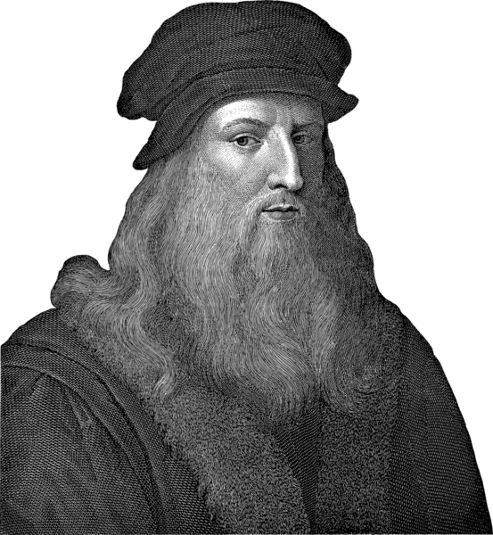
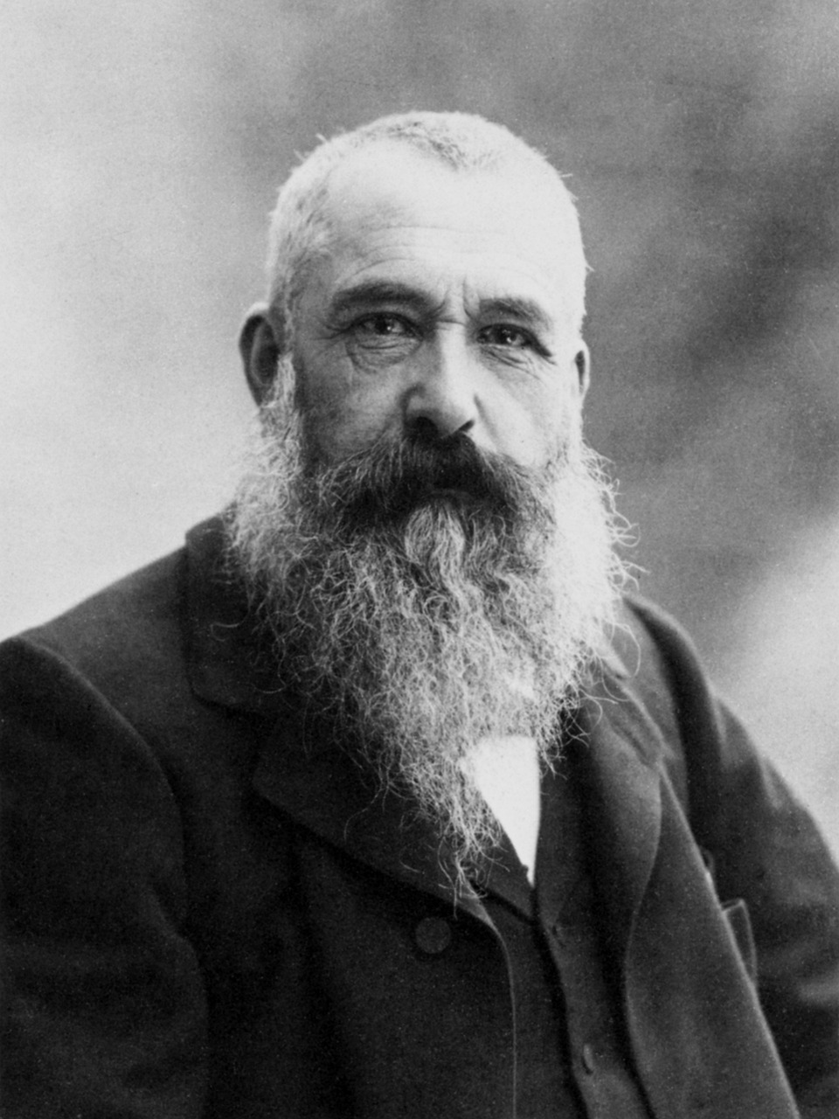
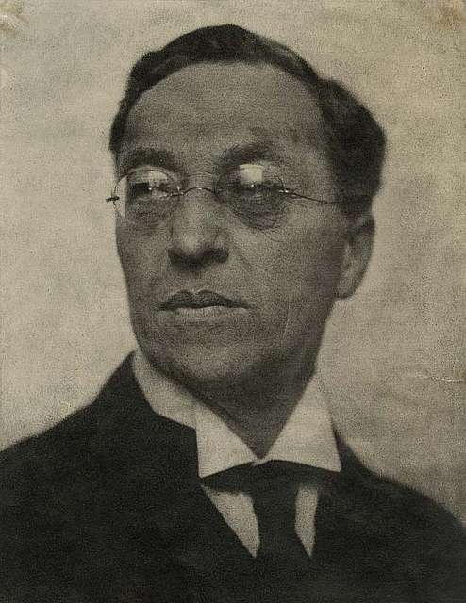
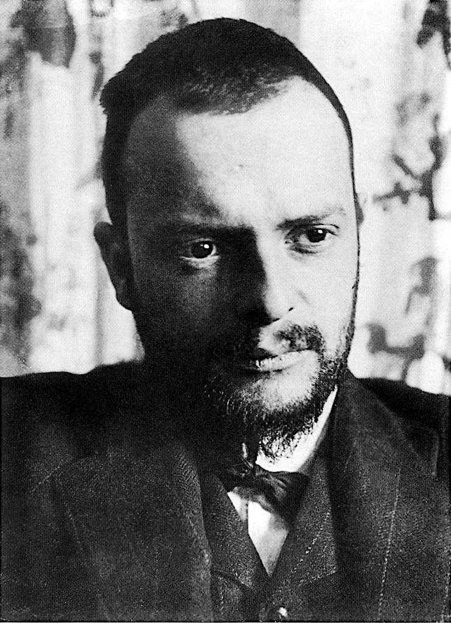
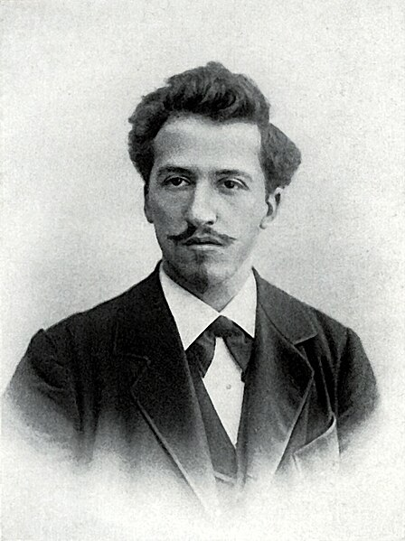
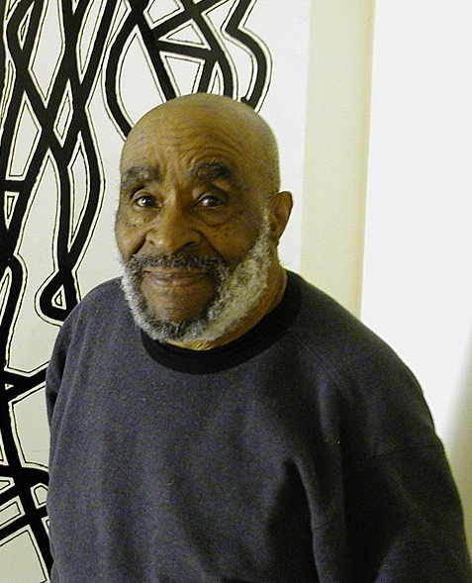
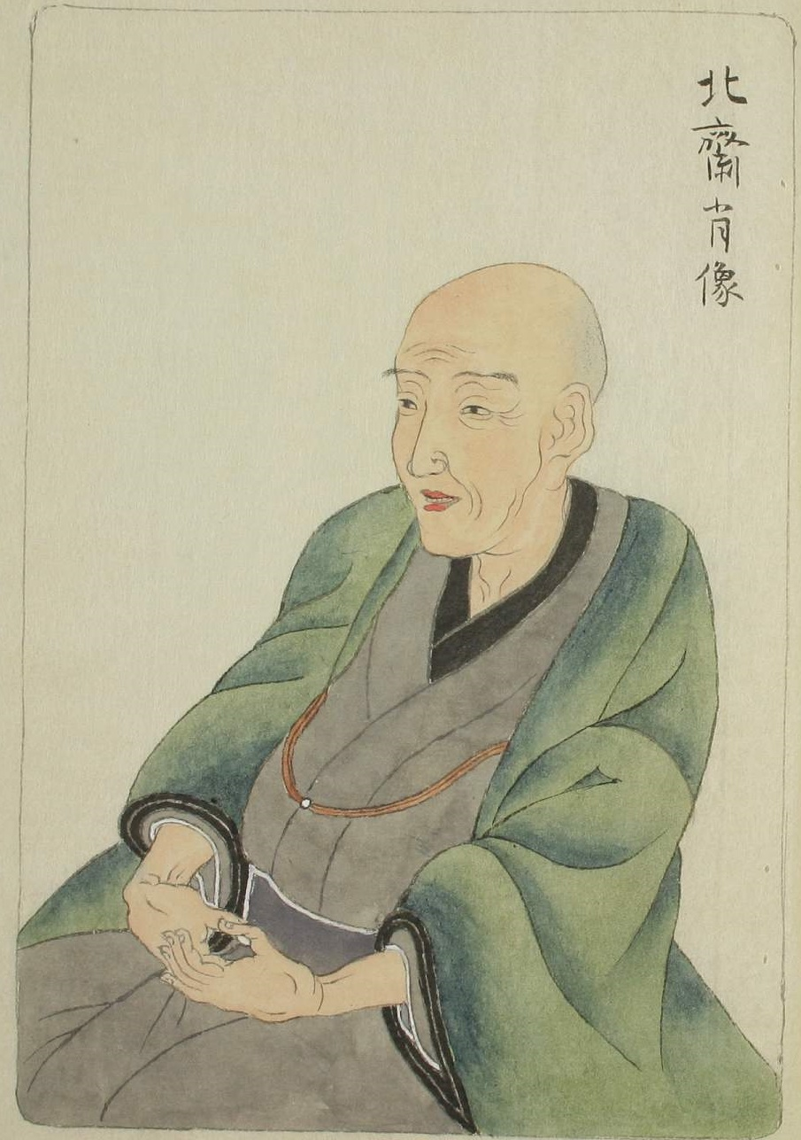
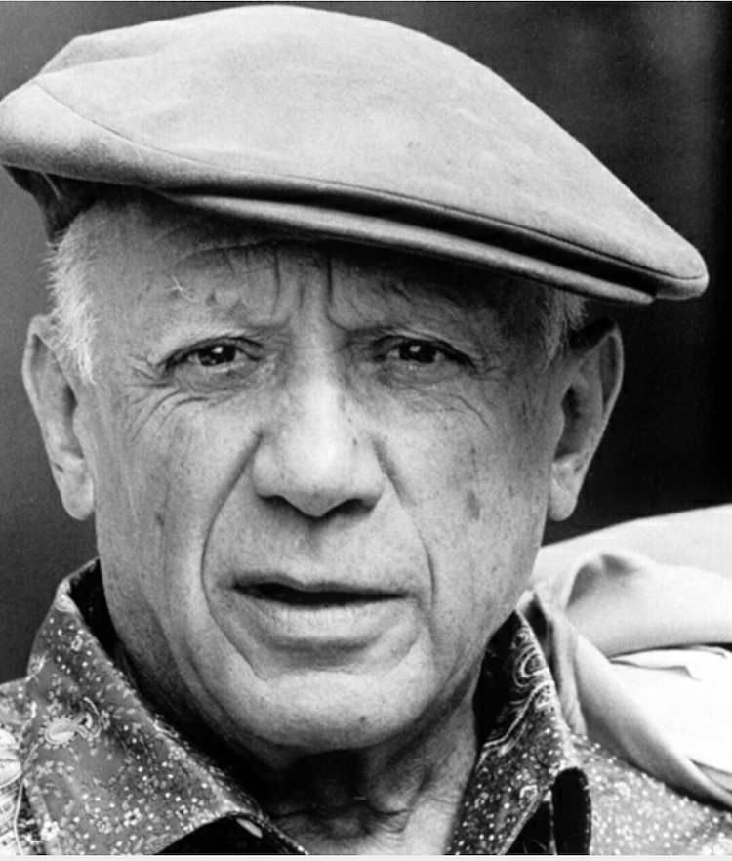
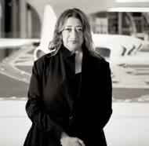
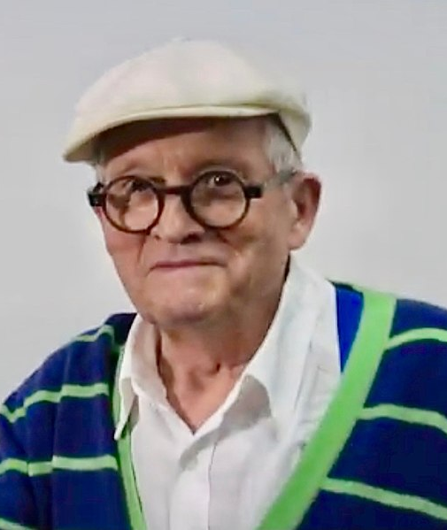
Artists in the Art & Design Curriculum
NB. The key artists in these slides will ensure that pupils can see high-quality examples of practical knowledge, as well as be exposed to artists who have made great contributions to global art, building their cultural capital. Many of the artists also allow all pupils to see themselves reflected positively in the curriculum. However, much of art history has been dominated by white men. Therefore, to ensure a diverse and inclusive curriculum, we have also included ‘hinterland’ artists – shown in grey. Their work may be less mainstream or prominent from art history perspective, but their inclusion in the curriculum ensures that all pupils have positive role models within the field of art.
Year 1
Leonardo Da Vinci
1452-1519
Claude Monet
1840-1926
Wassily Kandinsky
1866-1944
Paul Klee
1879-1940
Piet Mondrian
1872-1944
Charles McGee
1924-2021
(Frances Hatch)
Year 2
Katsushika Hokusai
1750-1849
Claude Monet
1840-1926
Pablo Picasso
1881-1973
(Boyle Family)
Active c.1960-
Zaha Hadid
1950-2016
David Hockney
1937-
(Emily Haworth-Booth)
Da Vinci - Luciaroblego, CC BY-SA 4.0, via Wikimedia Commons
McGee - Wmjuntunen (talk) (Uploads), CC BY-SA 3.0, via Wikimedia Commons
Hockney - Connaissance des Arts, CC BY 3.0, via Wikimedia Commons
Notes:
Da Vinci (CC BY-SA 4.0) - https://commons.wikimedia.org/wiki/File:Leonardo_da_vinci_retrato.png
Monet (CC0) - https://pixabay.com/fr/photos/peintre-artiste-claude-monet-62934/
Kandinsky (CC0) - https://picryl.com/media/wassily-kandinsky-1922-by-hugo-erfurth-b0aa00
Klee (CC0) - https://garystockbridge617.getarchive.net/media/paul-klee-1911-bb0bab
Mondrian (CC0) - https://commons.wikimedia.org/wiki/File:Piet_Mondriaan.jpg
McGee (CC BY-SA 3.0) cropped - https://commons.wikimedia.org/wiki/File:Charles_McGee2007.JPG
**Frances Hatch - https://www.linkedin.com/in/frances-hatch-3b099931/?originalSubdomain=uk
Hokusai (CC0) - https://commons.wikimedia.org/wiki/File:Portrait_of_Hokusai_by_Keisai_Eisen.jpg
Monet (CC0) - https://pixabay.com/fr/photos/peintre-artiste-claude-monet-62934/
Picasso (CC0) - https://freesvg.org/1542654356
**Boyle Family - https://luhringaugustine.viewingrooms.com/viewing-room/21-boyle-family-nothing-is-more-radical-than-the-facts/
Hadid (Free art licence) - https://commons.wikimedia.org/wiki/File:Zaha_Hadid_in_Heydar_Aliyev_Cultural_center_in_Baku_nov_2013.jpg
**Emily Howarth Booth - https://www.bigdrawshop.co.uk/blogs/news/interview-with-emily-haworth-booth

Slide 25
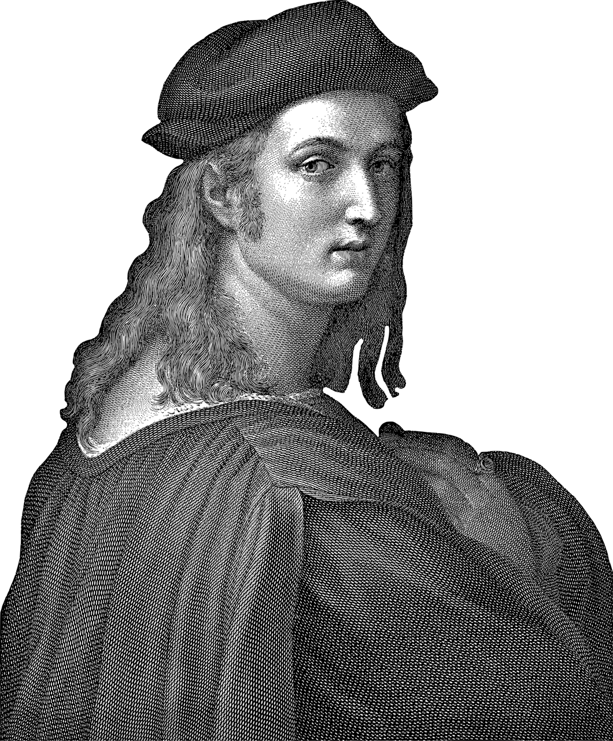
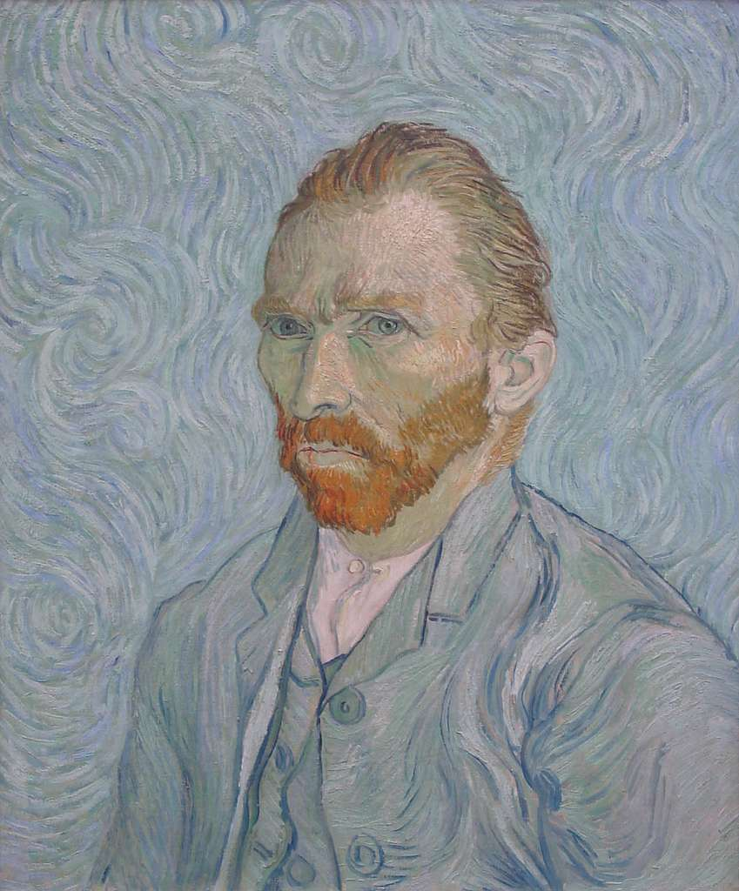
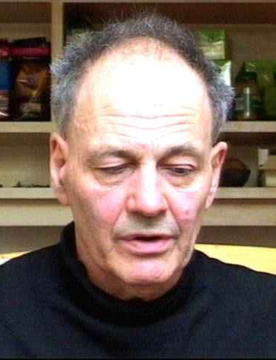
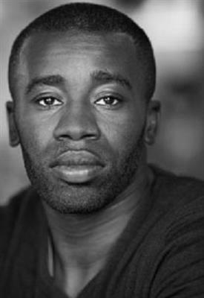
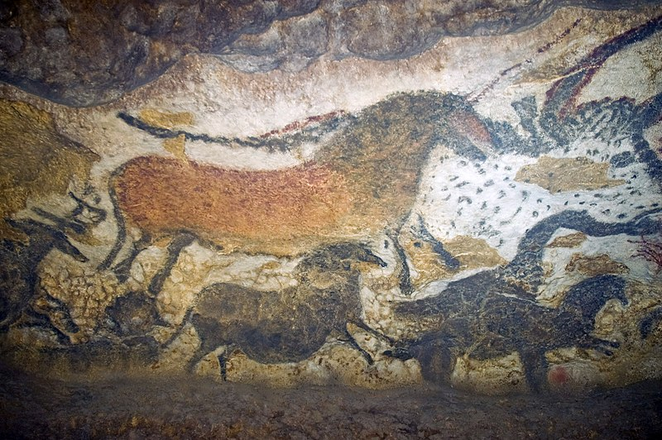
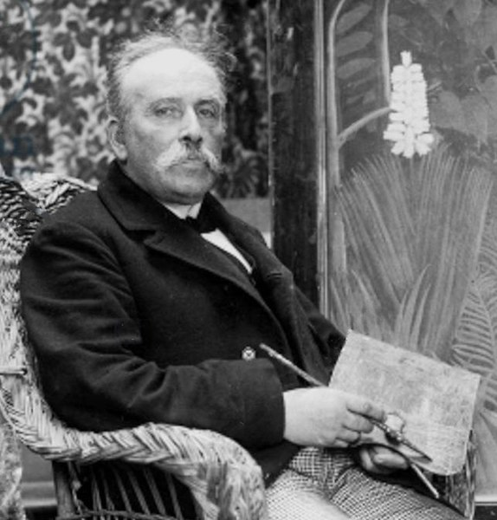
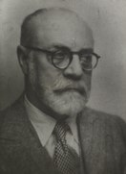
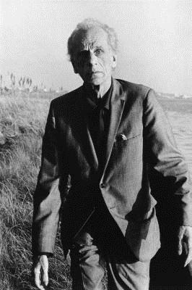
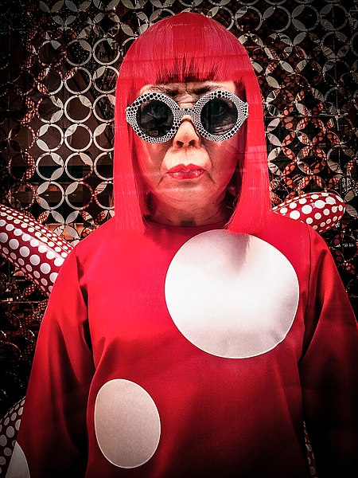
Artists in the Art & Design Curriculum
NB. The key artists in these slides will ensure that pupils can see high-quality examples of practical knowledge, as well as be exposed to artists who have made great contributions to global art, building their cultural capital. Many of the artists also allow all pupils to see themselves reflected positively in the curriculum. However, much of art history has been dominated by white men. Therefore, to ensure a diverse and inclusive curriculum, we have also included ‘hinterland’ artists – shown in grey. Their work may be less mainstream or prominent from art history perspective, but their inclusion in the curriculum ensures that all pupils have positive role models within the field of art.
Year 3
Lascaux Cave Art
17 000 – 15 000 BC
Raphael
1483-1520
Vincent Van Gogh
1833-1898
Frank Auerbach
1931-
(Quentin Blake)
1932-
(Anthony Browne)
1946-
(Satoshi Kitamura)
1937-
Chris Ofili
1968-
Year 4
Henri Rousseau
1844-1910
Henri Matisse
1869-1954
Joseph Cornell
1903-1972
Yayoi Kusama
1929-
(Abel Rodriguez)
1941-
Lascaux - Jack Versloot, CC BY 2.0, via Wikimedia Commons
Auerbach - Luke McKernan, CC BY-SA 2.0, via Wikimedia Commons
Kusama - Garry Knight, CC BY 2.0, via Wikimedia Commons
Notes:
Lascaux (CC BY 2.0) - https://commons.wikimedia.org/wiki/File:Lascaux_II.jpg
Raphael (CC0) - https://pixabay.com/fr/vectors/raphael-raffaello-sanzio-da-urbino-6539439/
Van Gogh (CC0) - https://picryl.com/media/selbstportrat-van-gogh-50d521
Frank Auerbach (CC BY-SA 2.0) - https://commons.wikimedia.org/wiki/File:Frank_Auerbach.jpg
**Chris Ofili - https://www.wikiart.org/en/chris-ofili
Rousseau (CC0) - https://commons.wikimedia.org/wiki/File:Rousseau_Joyeux_Farceurs_Dornac_crop.jpg
Matisse (CC0) - https://commons.wikimedia.org/wiki/File:Henri_Matisse_(1954).tiff
Cornell (CC) - https://en.wikipedia.org/wiki/File:Joseph_Cornell_1971.jpg
Kusama (CC BY 2.0) - https://commons.wikimedia.org/wiki/File:Yayoi_Kusama_wax_model_at_Louis_Vitton.jpg

Slide 26
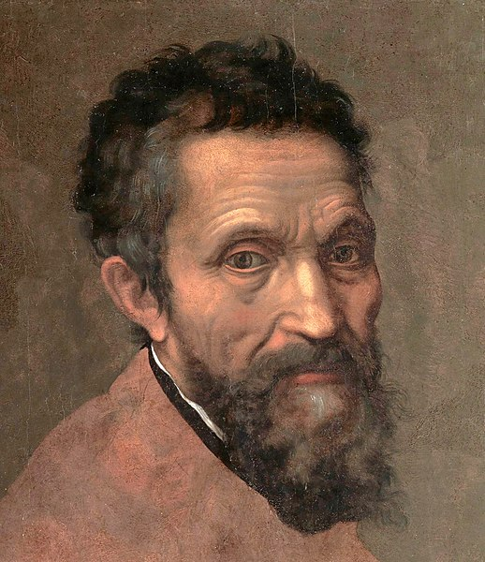
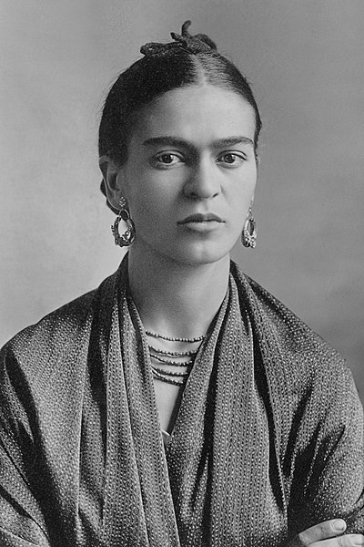
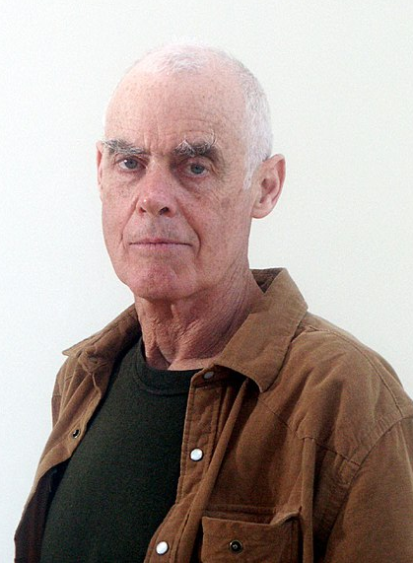
Artists in the Art & Design Curriculum
NB. The key artists in these slides will ensure that pupils can see high-quality examples of practical knowledge, as well as be exposed to artists who have made great contributions to global art, building their cultural capital. Many of the artists also allow all pupils to see themselves reflected positively in the curriculum. However, much of art history has been dominated by white men. Therefore, to ensure a diverse and inclusive curriculum, we have also included ‘hinterland’ artists – shown in grey. Their work may be less mainstream or prominent from art history perspective, but their inclusion in the curriculum ensures that all pupils have positive role models within the field of art.
Year 5
Leonardo
1452-1519
Raphael
1483-1520
Michelangelo
1475-1564
Frida
Kahlo
1907-1954
Mona Hatoum
1952-
Richard
Long
1945-
Lubaina Himid
1954-
Jackie
Morris
1961-
Marjane Satrapi
1969-
Mark
Hearld
1974-
Mel Tregonning
1983-2014
William
Grill
1990-
Year 6
Camille Pissarro
1830-1903
Kurt Schwitters
1887-1948
Judith Kerr
1923-2019
Sonia Boyce
1962-
Yinka Shonibare
1962-
Katharine Harvey
1963-
Veronika Richterová
1964-
Stephen Wiltshire
1974 -
Ifeoma Anyaeji
1981-
Serge Attukwei Clottey
1985-
Da Vinci - Luciaroblego, CC BY-SA 4.0, via Wikimedia Commons
Notes:
Leonardo (CC BY-SA 4.0) - https://commons.wikimedia.org/wiki/File:Leonardo_da_vinci_retrato.png
Raphael (CC0) - https://pixabay.com/fr/vectors/raphael-raffaello-sanzio-da-urbino-6539439/
Michelangelo (CC0) - https://commons.wikimedia.org/wiki/File:Michelangelo_Daniele_da_Volterra_(dettaglio).jpg
Kahlo (CC0) - https://commons.wikimedia.org/wiki/File:Frida_Kahlo,_by_Guillermo_Kahlo.jpg
Lubaina Himid - https://youtu.be/E0T_8JE13kU
Boyce - https://youtu.be/vRB6H06UpJ4
Shonibare - https://youtu.be/WroXoWaGfL8

Slide 27
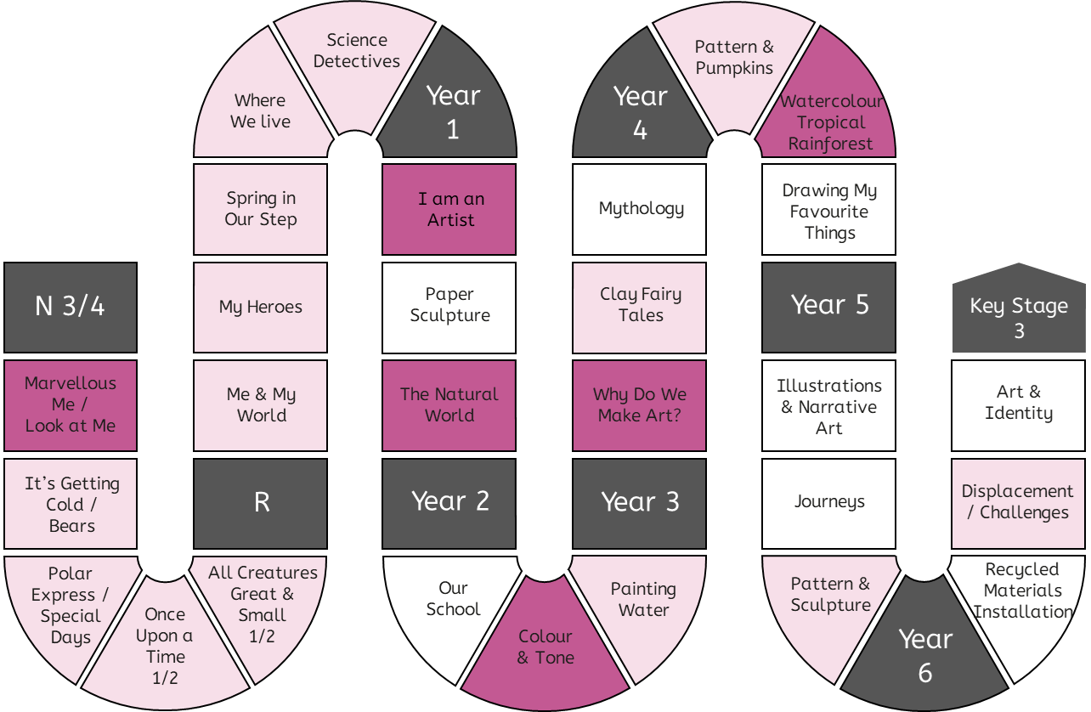
Progression in Practical Knowledge
Formal Elements
Primary colours are red, blue and yellow. They cannot be mixed from other colours.
Secondary colours are green, orange and purple. They are mixed from primary colours.
The appearance of secondary colours can vary according to the amount of each primary colour used to mix it.
Colour
Earthy colours are reds, browns, oranges (colours of earth).
Tone
Line
Tertiary colours are red-orange, yellow-orange, yellow-green, blue-green, blue-purple, red-purple. They are mixed from one primary and one secondary colour.
Form
Use colours that are representative of real objects and how I feel.
Space
Shape
Pattern
Texture
Control of Materials
Prior knowledge of colour is explicitly reviewed in units across EYFS-KS2.
Mark Making
Painting
Drawing
Printing
Sculpture
Digital
Artists can change the way a colour looks by making tints (adding white), tones (adding grey) and shades (adding black).
Warm colours are red, orange and yellow. Cool colours are blue, purple and green.
Colours can be used to represent emotions. For example, red can represent anger and blue can represent sadness.
Mixed Media

Slide 28
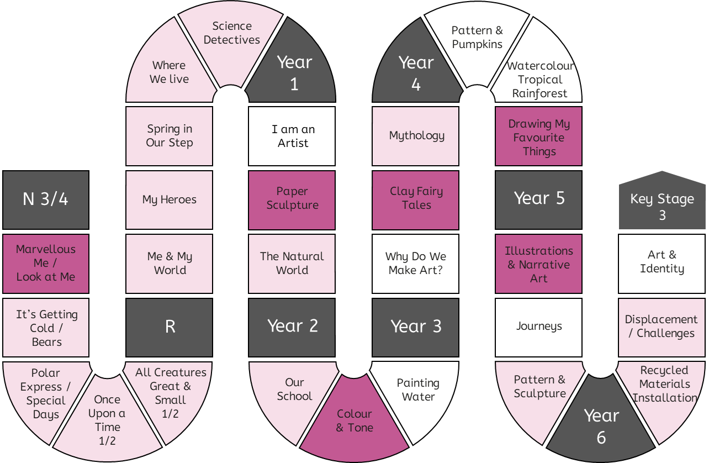
Progression in Practical Knowledge
Tone is about light and dark in an artwork. A strong tone means there is a big difference (contrast) between the light and the dark areas.
Doing the same thing with different materials - like pencil, fineliner, biro, felt tip - can create a different tone.
Shadows are an area of darkness that can be created by a sculpture or other 3D object.
Formal Elements
Colour
Tone
Tone can be created using the same pencil by pressing harder or lighter.
Line
Explore mark making with different materials and using different pressure to create lighter and darker marks.
Form
Tone can be created using different grades of pencil.
Space
Shape
Pattern
Texture
Control of Materials
Mark Making
Prior knowledge of tone is explicitly reviewed in units across EYFS-KS2.
Painting
Drawing
Printing
Sculpture
Tone can be created using white pens and pencils, which highlight areas of the artwork.
Linear shading is a method of creating tone, often with a pen.
Examples of linear shading include hatching, cross hatching and contoured hatching.
Digital
Manipulate shadows using torches to create a different tone.
Mixed Media

Slide 29
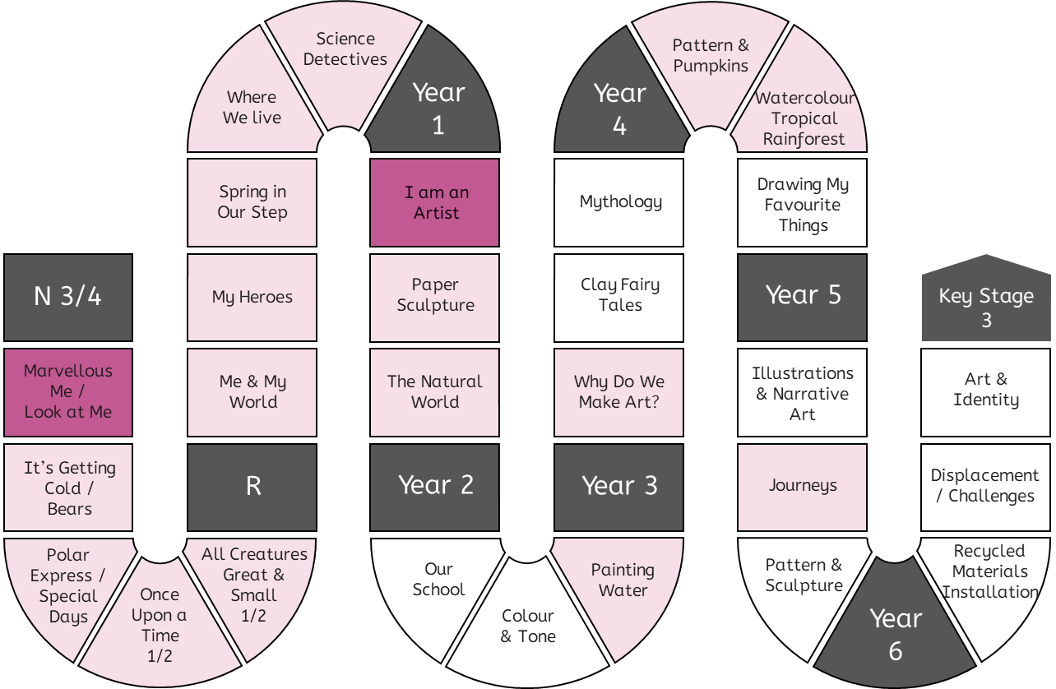
Progression in Practical Knowledge
A line is a mark made on a surface that joins different points.
Lines can vary in length, width, direction and shape.
A continuous line drawing is one where the pencil does not leave the page.
Doing the same thing with different materials - like pencil, crayon, pens, charcoal - can create different lines.
Formal Elements
Colour
Tone
Line
Prior knowledge of line is explicitly reviewed in units across EYFS-KS2.
Form
Make marks including lines and closed shapes.
Space
Shape
Pattern
Texture
Control of Materials
Mark Making
Painting
Drawing
Printing
Sculpture
Digital
Mixed Media

Slide 30
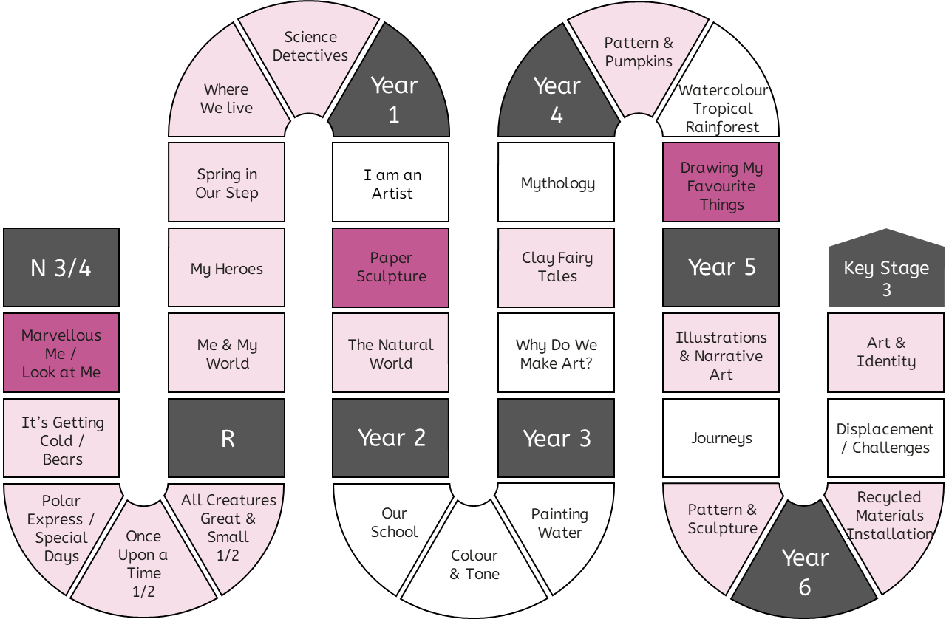
Progression in Practical Knowledge
A form is something that you can view from all sides [it is 3D].
A form can be created as a sculpture.
Formal Elements
Colour
Tone
Line
A form can be represented using tone in a 2D artwork.
Form
Space
Make 3D sculptures in junk modelling.
Shape
Pattern
Texture
Control of Materials
Mark Making
Painting
Drawing
Printing
Sculpture
Digital
Prior knowledge of form is explicitly reviewed in units across EYFS-KS2.
Mixed Media

Slide 31
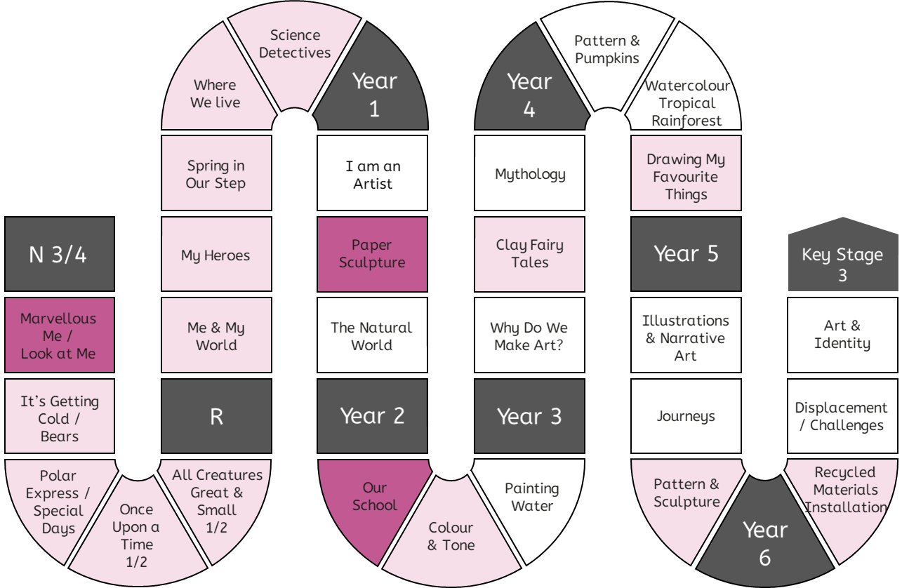
Progression in Practical Knowledge
Formal Elements
Space is an area around an object. Space is created when you make a 3D sculpture (e.g. the gap between two parts of the sculpture).
Colour
Tone
Line
Form
Space
Implicitly create space when junk modelling.
Shape
Pattern
Texture
Control of Materials
Mark Making
Painting
Drawing
Printing
Sculpture
Digital
Space can be found around existing objects and used to create art.
Prior knowledge of space is explicitly reviewed in units across EYFS-KS2.
Mixed Media

Slide 32
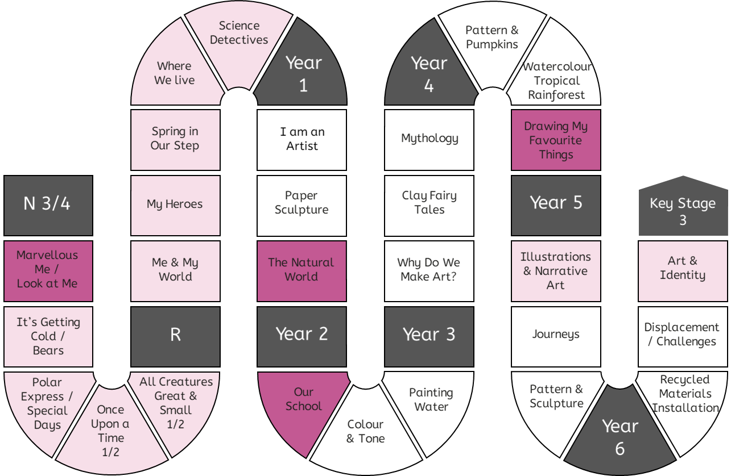
Progression in Practical Knowledge
Formal Elements
Drawing can be about representing flat [2D] objects using [2D] shapes on paper.
Colour
Tone
Drawing can be about representing 3D forms with 2D shapes on paper (a 2D surface).
Line
Form
Select items in junk modelling based on their shape.
Space
Shape
Pattern
Texture
Control of Materials
Mark Making
Painting
Drawing
Printing
Sculpture
Digital
Shapes can be found in existing objects and used to create art.
Prior knowledge of shape is explicitly reviewed in units across EYFS-KS2.
Mixed Media

Slide 33
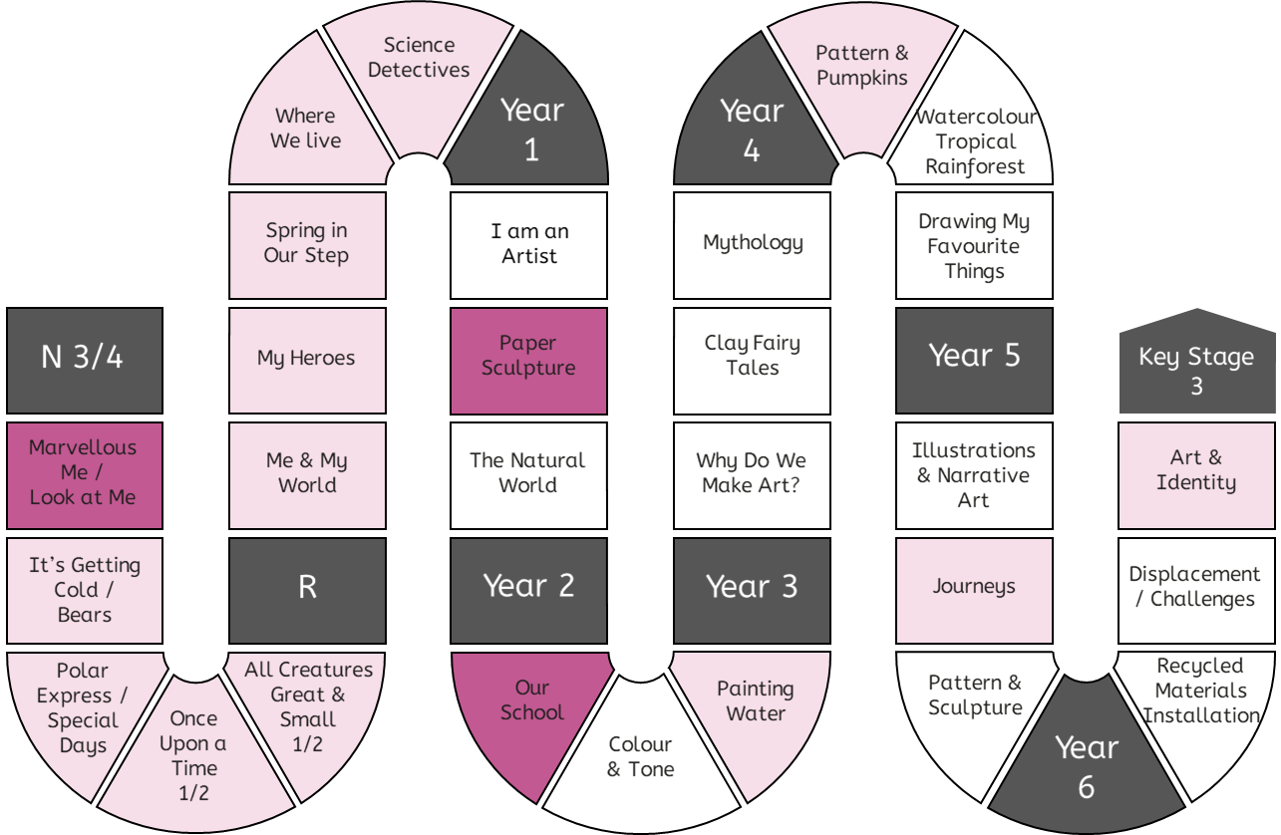
Progression in Practical Knowledge
Formal Elements
Patterns can be created with a series of repeated marks like dots and lines.
Colour
Tone
Line
Prior knowledge of pattern is explicitly reviewed in units across EYFS-KS2.
Form
Space
Create patterns when making marks. Describe patterns.
Shape
Pattern
Texture
Control of Materials
Mark Making
Painting
Drawing
Printing
Sculpture
Identify patterns in the world around us.
Digital
Mixed Media

Slide 34
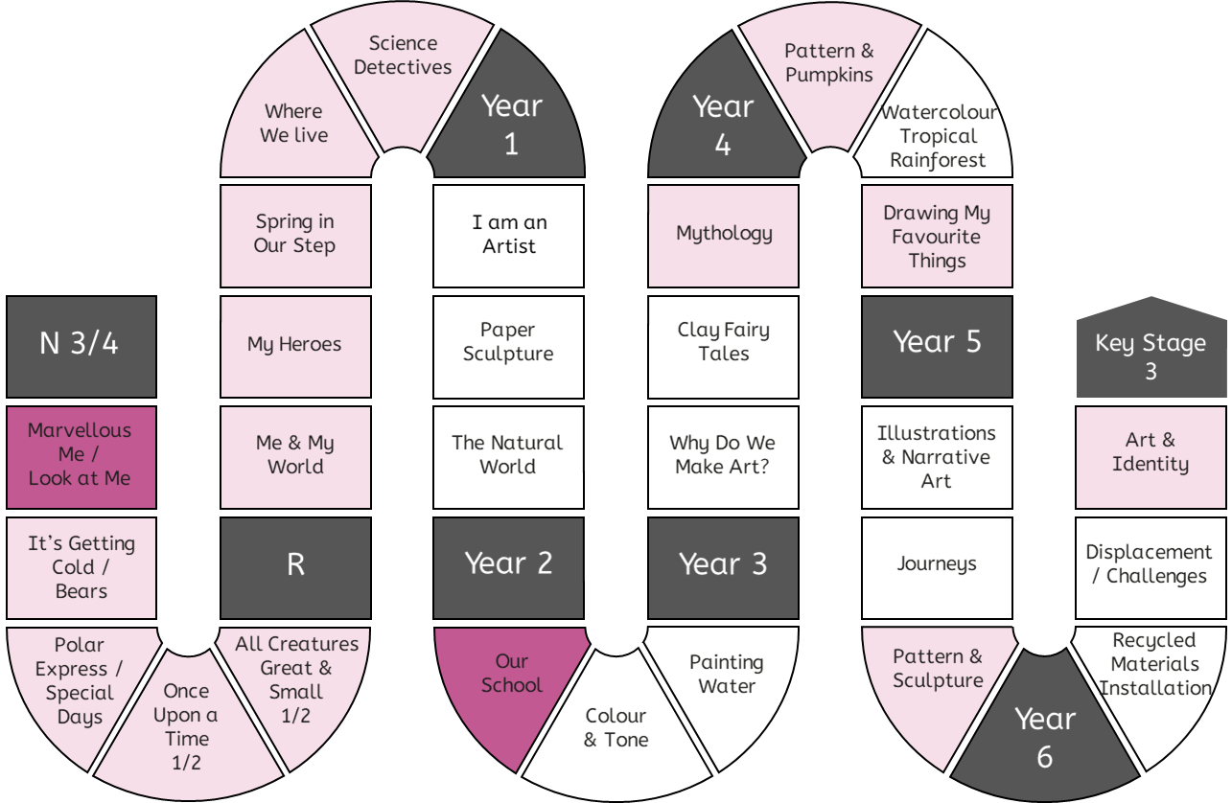
Progression in Practical Knowledge
Formal Elements
Colour
Tone
Line
Prior knowledge of texture is explicitly reviewed in units across EYFS-KS2.
Form
Describe how materials feel using words like rough and smooth.
Space
Shape
Pattern
Texture
Control of Materials
Mark Making
Painting
Drawing
Printing
Sculpture
Digital
Texture is how something feels. Artists can make art that tells us how something might feel, without us having to touch it.
Mixed Media

Slide 35
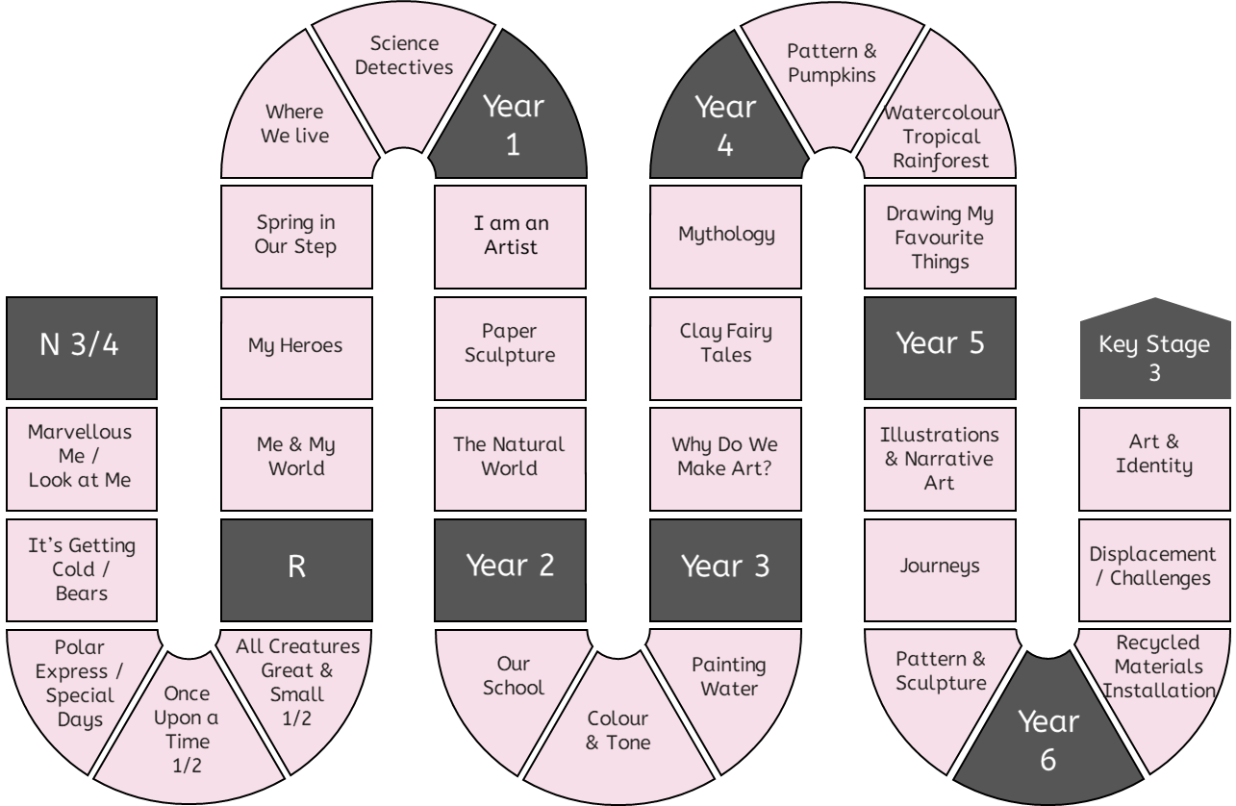
Progression in Practical Knowledge
Formal Elements
Focus on pencils and paintbrushes.
Focus on wax crayons.
Focus on pens and pencils.
Colour
Tone
Line
Use mark-making tools with a palmer grasp or digital pronate grasp.
Use mark-making tools with a static tripod grip.
Form
Space
Focus on pens.
Shape
Pattern
Texture
Control of Materials
Mark Making
Painting
Drawing
Printing
Sculpture
Digital
Use mark-making tools with a dynamic tripod grip.
Focus on using crayons on their side to create rubbings.
Focus on chalk pastels.
Mark making tools are used in every unit. Examples have been included to show the range of mark-making tools that are used EYFS-KS2.
Mixed Media

Slide 36
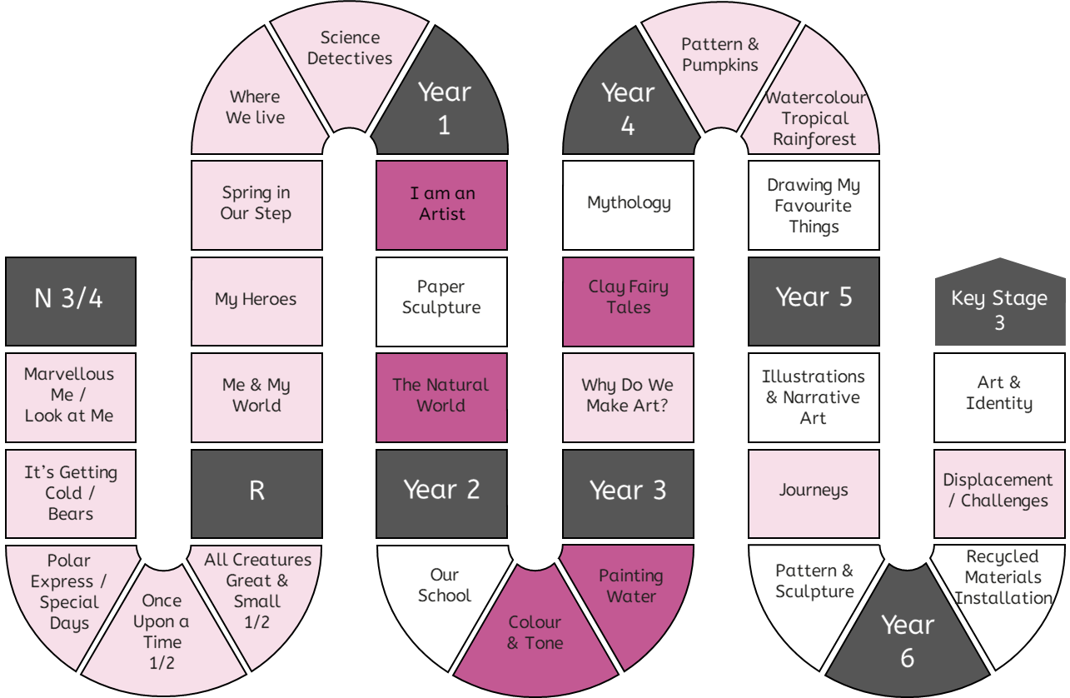
Progression in Practical Knowledge
Formal Elements
Use poster paints.
Use wax resist technique with watercolour paints.
Mix colours using watercolour paints on the page (not in a palette).
Use a flat wash brushstroke with watercolour paint.
Colour
Tone
Prior knowledge of painting is explicitly reviewed in units across EYFS-KS2.
Line
Explore mark making with paints with increasing confidence and skill.
Form
Mix colours using acrylics paints in a palette.
Space
Shape
Pattern
Texture
Control of Materials
Mark Making
Painting
Drawing
Printing
Sculpture
Mix colours using poster paints in a palette.
Use stippling, tapered and dry brushstrokes with watercolour paint.
Use wet on wet and 'less to more see through' [opaque to translucent] techniques.
Use different amounts of water to create stronger [more opaque] and weaker [more translucent] colours.
Different paintbrushes are suited to different brush strokes and techniques.
Digital
Mixed Media

Slide 37
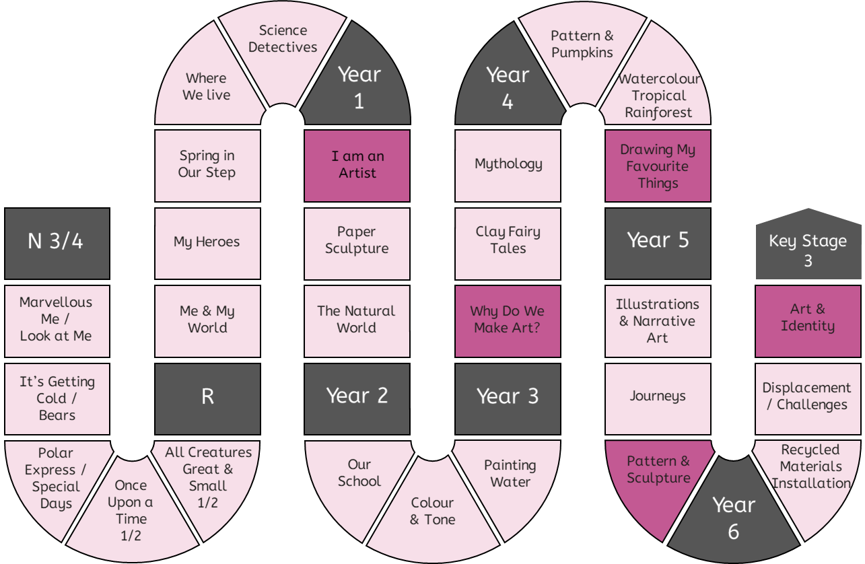
Progression in Practical Knowledge
Formal Elements
Making simple line drawings, including continuous line drawings.
Drawing is a key skill in Art & Design and reviewed in some way in every unit.
Colour
Tone
Line
Form
Make a tonal drawing using pencil.
Space
Make marks to draw familiar things.
Shape
Pattern
Texture
Control of Materials
Draw the human face and its features in proportion using pencil.
Mark Making
Painting
Drawing
Printing
Sculpture
When drawing from observation artists must look often and very carefully and at the object they're drawing from.
When drawing from primary observation, artists look at the object they're drawing from. When drawing from secondary observation, artists look at a drawing or a copy of object.
Digital
Mixed Media

Slide 38
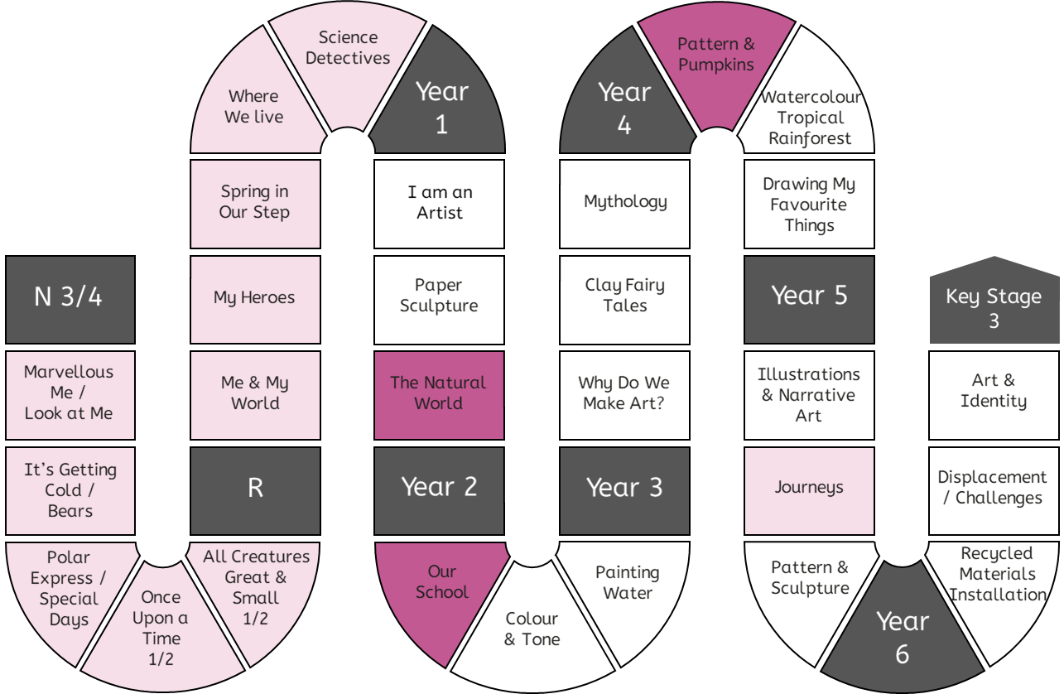
Progression in Practical Knowledge
Formal Elements
Press print onto paper or fabric using the natural colour of the leaves.
Collagraphic printmaking is a process in which materials are built up on a plate to be printed from.
Colour
Tone
Line
Form
Make simple prints using poster paints.
Space
Prior knowledge of printing is explicitly reviewed.
Shape
Pattern
Texture
Control of Materials
Mark Making
Painting
Drawing
Printing
Sculpture
Digital
Using crayons to transfer texture and pattern from existing surfaces.
Monoprint onto paper.
Create a plate to make a press print. Apply ink (or paint) with a roller. Press print onto paper or fabric using a plate.
Mixed Media

Slide 39
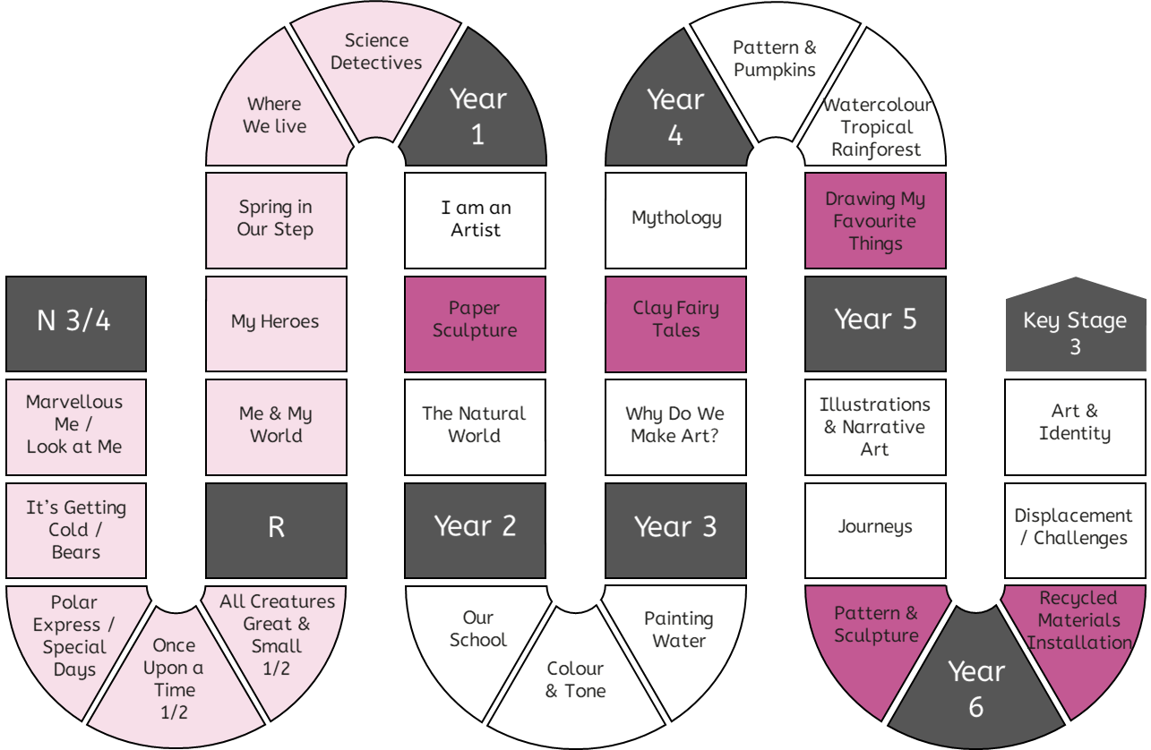
Progression in Practical Knowledge
Formal Elements
Create a paper sculpture by folding and twisting and gluing it together.
Arrange a 3D composition by considering size, shape, texture and space between objects.
Colour
Tone
Line
Form
Explore making sculptures using a range of materials and junk modelling.
Origami is a Japanese artform of creating 3D models by folding a piece of paper.
Space
Shape
Pattern
Texture
Control of Materials
Mark Making
Painting
Drawing
Printing
Cut, shape and manipulate existing objects to create a sculpture.
Sculpture
Make a tile using clay.
Make a raised relief by adding layers of clay.
Use slip (a mixture of clay and water) as a glue in ceramics.
Score surfaces before adding slip to help the pieces attach more reliably.
Digital
Mixed Media

Slide 40
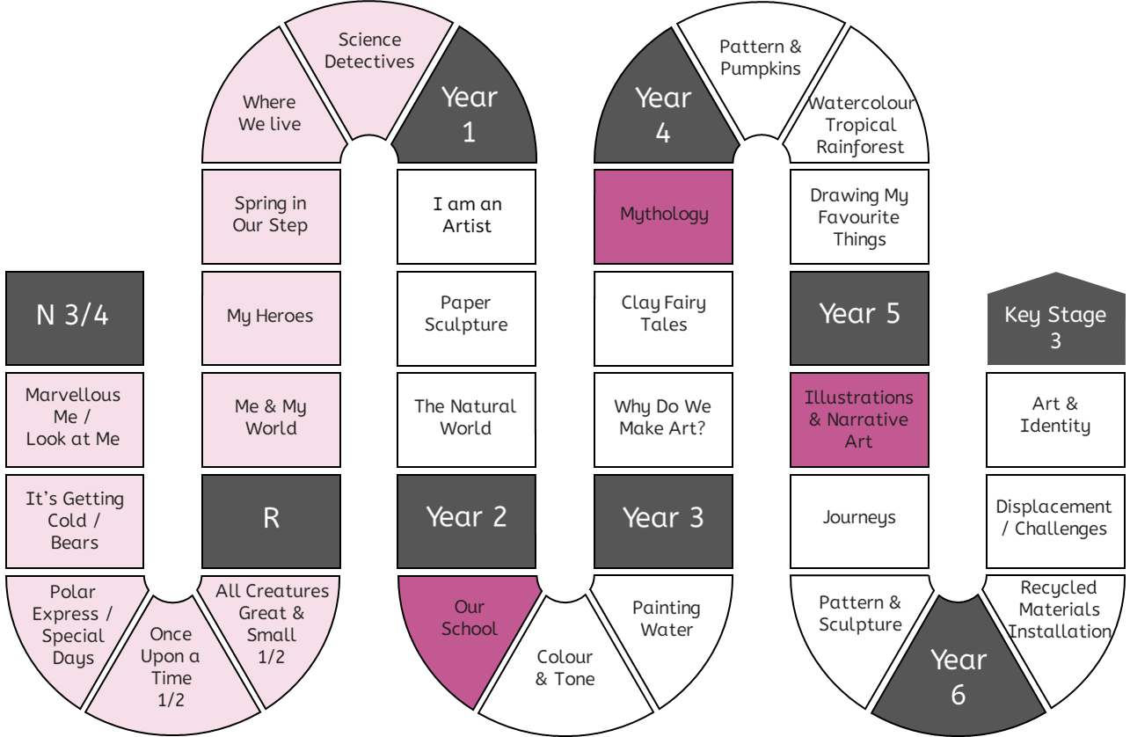
Progression in Practical Knowledge
Formal Elements
Take photographs of tableau vivant, which is made by standing still to represent the figures in a story.
Colour
Tone
Line
Form
Design figures and characters in software programmes (e.g. PowerPoint).
Space
Shape
Pattern
Texture
Control of Materials
Mark Making
Painting
Drawing
Printing
Sculpture
Digital
Take photographs of objects and surfaces using cameras or tablets.
Mixed Media

Slide 41
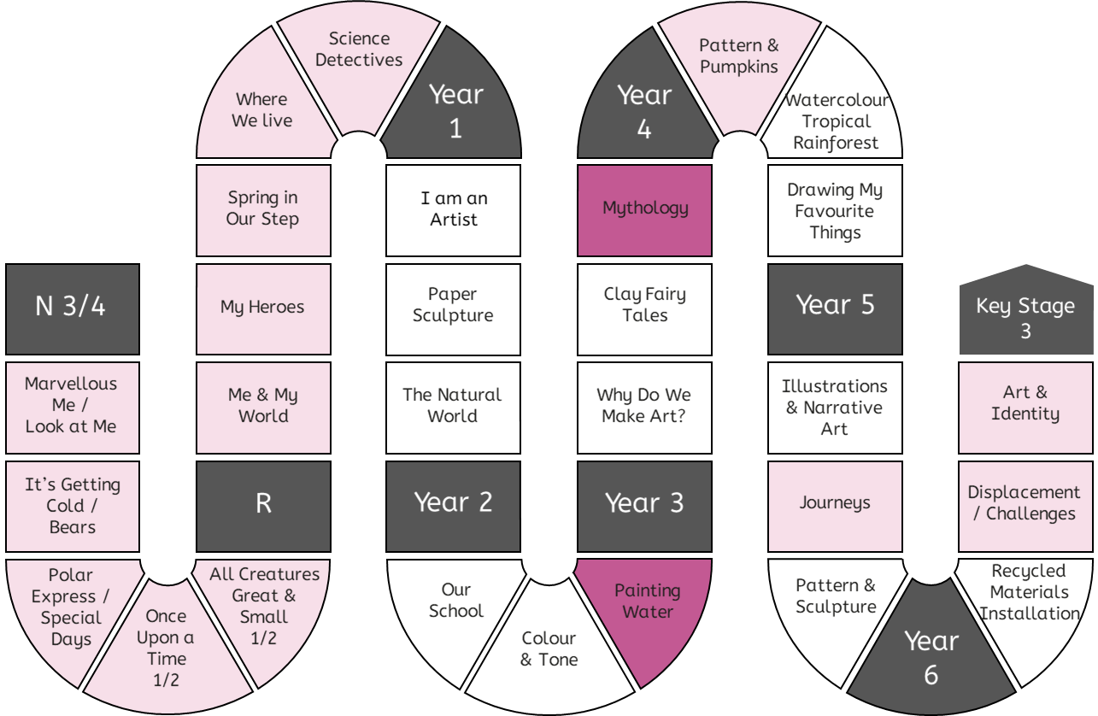
Progression in Practical Knowledge
Formal Elements
Create a montage.
Colour
Tone
Line
Prior knowledge of mixed media is explicitly reviewed in units across EYFS-KS2.
Form
Space
Shape
Pattern
Texture
Control of Materials
Mark Making
Painting
Drawing
Printing
Sculpture
Digital
Create a collage.
Mixed Media

Slide 42
Progression in Theoretical Knowledge
Different Artworks
EYFS | Illustrations are the pictures in a book that tell a story. Different artists make art in different ways.
Y1 | Abstract art is art that does not try to look like things in the real world. Instead, it is made up of shapes, colors, and lines that might not look like anything you recognize. Representational art tries to look like things in the real world, such as people, animals, or objects. When you look at representational art, you can usually tell what it is supposed to be. Art can be flat [2D] or something that you look around [3D]. A sculpture is an artwork can be viewed from all sides [it is 3D]. A sculptor is an artist who makes sculptures.
Y2 | Illustrations help to tell a story. Artists who make illustrations are called illustrators. A collage is an artwork made by sticking pieces of paper or other materials onto a background.
Y3 | Mixed-media is artwork that uses more than one art material e.g., paint and pens. Ceramics is the process of making art from clay. A montage is a mixed-media artwork including collaged photographs. Traditional art describes everything from early Christian art to the 1850s and is usually representational. Modern art describes art made from around the 1850s to the 1970s. Modern artists wanted their art to show how they felt. It was more abstract than representational. Contemporary art describes artwork being made by living artists, or art that has been made recently (e.g., 1980s onwards). Contemporary art can be anything and artists create work using traditional, modern and other techniques. Traditional, modern and contemporary art definitions can only be applied to western art. Artists can arrange objects or images in a composition. Traditional composition is often made up of foreground, midground and background. Perspective is the way a flat (2D) image looks deep (3D). Illustrations help to tell a story. Narrative art tells a story on its own.
Y4 | A viewfinder can be used to identify an interesting section within a composition. An assemblage is a 3D artwork usually made of found objects. A still life is a genre of artwork that shows a collection of objects.
Y5 | Artwork does not have to be abstract or representational. It is a spectrum. Some artworks are representational (so you can recognise the objects from the real world), but they don't look realistic. Expressive art conveys emotions and feelings. There are more examples of expressive art in modern and contemporary than traditional art. Expressive art can be representational or abstract.
Y6 | Installation art is designed to fill a specific space, often for a particular length of time. An exhibition is a display of artwork. It is curated by a curator.

Slide 43
Progression in Theoretical Knowledge
Traditional, Modern and Contemporary Artists
Klee
(1910-40s) – Y1
Mondrian
(1910-40s) – Y1
Kandinsky
(1910s-20s) – Y1
Hockney
(1960-2020s) – Y2
Auerbach
(1960-2020s) – Y3
Long
(1960-2020s) – Y5
Rousseau
(1750-1780s) – Y4
Hokusai*
(1820-30s) – Y2
Van Gogh
(1880-90s) – Y3
Matisse
(1940-50s) – Y4
Himid
(1980-2020s) – Y5
1490
1500
1520
1520
1750
1760
1770
1780
1790
1800
1810
1820
1830
1840
1850
1860
1870
1880
1890
1900
1910
1920
1930
1940
1950
1960
1970
1980
1990
2000
2010
2020
2030
Leonardo (1470s-1500s) – Y1
Raphael (1500s-1520) – Y3
Michelangelo (1500s-40s) – Y5
Monet
(1860-1900s) – Y1
McGee
(1950-2020s) – Y1
Kusuma
(1950-2020s) – Y1
Hadid
(1990-2010s) – Y2
Ofili
(1990-2020s) – Y3
Boyce
(1990-2020s) – Y6
Shonibare
(1990-2020s) – Y6
Picasso
(1900-50s) – Y2
Kahlo
(1930-40s) – Y5
*The art history terms traditional, modern and contemporary art are only applied to western art.

Slide 44
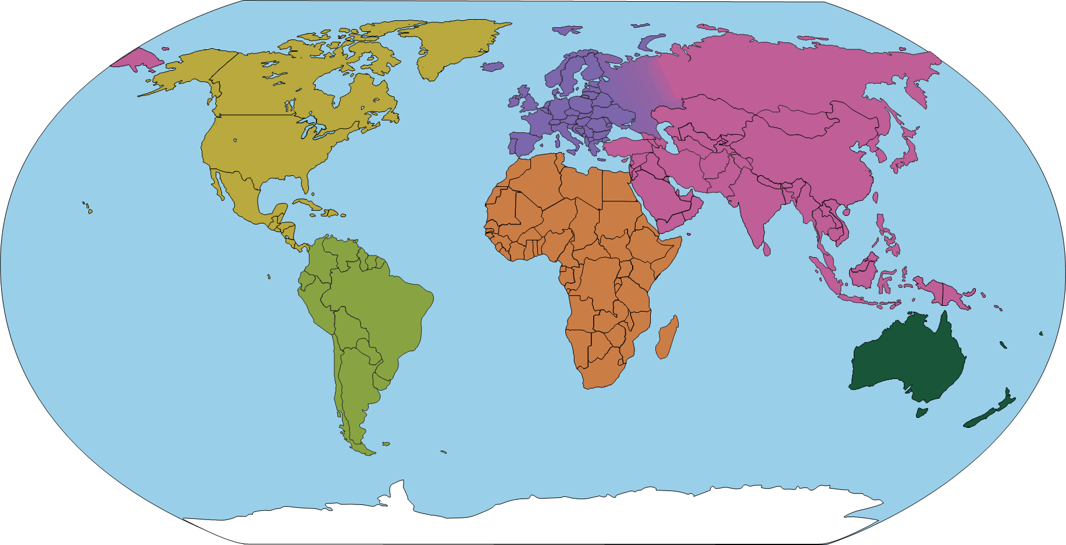
Progression in Theoretical Knowledge
Artists from around the world
UK
Hockney (Y2)
Ofili (Y3)
Long (Y5)
Himid (Y5)
Boyce (Y6)
France
Monet (Y1)
Rousseau (Y4)
Matisse (Y4)
Netherlands
Mondrian (Y1)
Van Gogh (Y3)
Italy
Raphael, Michelangelo, Leonardo (Y1, Y3)
Russia
Kandinsky (Y1)
Germany
Klee (Y1)
Auerbach (German-British) (Y3)
USA
McGee (Y1)
Spain
Picasso (Y2)
Japan
Hokusai (Y2)
Kusama (Y4)
Mexico
Kahlo (Y5)
Iraq
Hadid (British-Iraqi) (Y2)
Colombia
Rodriguez (Y4)
Nigeria
Anyaeji (Nigerian) Y6
Shonibare (British-Nigerian) (Y6)

Slide 45
Progression in Disciplinary Knowledge
 | What do artists do? | What inspires artists? | Understanding Artworks
EYFS | Artists explore and play. | Artists can be inspired by the stories they read. | Make statements about my artwork.
Y1 | Artists experiment, explore and play. A sketchbook is a special book that artists use. | Artists can be inspired by the natural world. | Review the above. Discuss the work of artists, including our own.
Y2 | Review the above. Artists often create art for its own sake. Designers create things that are useful and have a purpose. Sometimes artists are designers who create art for a specific purpose. Architects are artists and designers who design buildings. Art can be made by individual artists, or by a group of artists who collaborate. | Review the above. Artists can be inspired by hidden details in seemingly ordinary objects. Artists can be inspired by the artificial (man-made) world. | Review the above. Label the features of different artworks with key words.
Y3 | Review the above. Creating art is something humans have done from the very beginnings of their existence. Artists make choices about materials that are appropriate for their composition. | Review the above. Artists can be inspired by each other, and we can make connections between our artworks and theirs. | Review the above. Annotate the features of different artworks and the effects they have on the viewer.
Y4 | Review the above. | Review the above. Artists can be inspired by their own experiences and stories. | Review the above. Annotate my artwork with connections to another artist's work.
Y5 | Review the above. Artists can make mood boards to help them collect and shape ideas. | Review the above. | Review the above. Compare the artwork of two artists. Curate an exhibition, deciding how the artwork will be displayed.
Y6 | Review the above. | Review the above. Artists can be inspired to bring difficult or contentious issues to light and provoke debate and discussion. | Review the above. Write as an art historian to analyse artists and their artworks.

Slide 46
Alignment to the National Curriculum
The below tables outlines where the statutory content from the National Curriculum is first taught across KS1 or KS2. The curriculum has been sequenced so that much of the content is reviewed in subsequent units.
In KS1, pupils should be taught:
To use a range of materials creatively to design and make products | Y1 Aut, Y1 Spr, Y1 Sum, Y2 Aut
To use drawing, painting and sculpture to develop and share their ideas, experiences and imagination | Y1 Aut, Y1 Spr, Y1 Sum, Y2 Sum
To develop a wide range of art and design techniques in using colour, pattern, texture, line, shape, form and space | Y1 Aut, Y1 Spr, Y2 Aut, Y2 Sum
About the work of a range of artists, craft makers and designers, describing the differences and similarities between different practices and disciplines, and making links to their own work. | Y1 Aut, Y1 Spr, Y1 Sum, Y2 Aut, Y2 Sum
In KS2, pupils should be taught:
To develop their techniques, including their control and their use of materials, with creativity, experimentation and an increasing awareness of different kinds of art, craft and design. | Y3 Aut, Y4 Aut, Y4 Sum
To create sketch books to record their observations and use them to review and revisit ideas | (Y1) Y3 Aut, Y4 Aut, Y4 Spr, Y4 Sum, Y5 Aut, Y6 Sum
To improve their mastery of art and design techniques, including drawing, painting and sculpture with a range of materials [for example, pencil, charcoal, paint, clay] | Y3 Aut, Y3 Spr, Y4 Aut, Y4 Spr, Y4 Sum
About great artists, architects and designers in history. | Y3 Aut, Y3 Sum, Y4 Aut, Y4 Spr, Y5 Aut

